Slide 1

Effective Feedback
Notes:
Purpose:
The Effective feedback workshop includes information on feedback research and available resources, and includes workshop activities to support reflection and planning.
Key points:
The workshop is designed to assist teachers and school leaders to reflect on their current practice and to consider feedback practices that are relevant to their context.
It is likely, however, that teachers and school leaders will need to access further information about feedback practices and techniques to inform implementation.
The workshop connects to the feedback case studies, feedback strategies, Spotlight, animation and fact sheet. All are available at www.aitsl.edu.au/feedback.
The workshop discussions will assist with completing sections of the feedback Planning overview (Discussed in slide 23).
You may wish to run the workshop over several sessions, or to just focus on a particular section of the workshop.
You may also choose to remove slides that are not relevant to the feedback focus in your context or to add your own slides to cover further issues.
Estimated timing
The estimated time needed to complete the entire workshop is approximately 7 hours (if undertaking all suggested activities).

Slide 2
Workshop overview
Why look at feedback?
Feedback definition
Feedback in our context
Feedback questions
Feedback levels
Praise for effort
Practiced-centred collaboration
Feedback strategies in the classroom
Planning for action
Notes:
Purpose:
Provide participants with an overview of the workshop.
Estimated timing:
1 minute

Slide 3
Activity 1: Warm-up
ALL students can achieve significant learning growth
My beliefs about teaching and learning impact the way I teach
I am aware of the impact of my teaching on my students
My aim is to make my students self-regulated learners.
Notes:
Purpose:
The statements are intended to promote discussion through the use of an agreement scale activity.
The statements are designed to encourage consideration of staff beliefs and attitudes and to gain a sense of the school culture and climate before moving into learning more about feedback.
Key points:
“Teachers' beliefs not only determine what they do in the classroom but also influence what they count as evidence that learning has occurred. And unless professional learning experiences help teachers examine their working assumptions about how students learn and how good teaching supports learning, they will not make meaningful changes in their teaching practices” (Moss, CM & Brookhart, SM 2010, Advancing formative assessment in every classroom: A guide for instructional leaders. ASCD.)
Activity notes:
Note that the slide is animated so the statements will appear one at a time (on click).
The facilitator will need to create an agreement scale across the room, assigning one side of the room as the ‘strongly agree’ side, and the other as the ‘strongly disagree’ side.
Reveal a statement on the slide and asks participants to position themselves along the agreement scale.
Once everyone is positioned, the facilitator can encourage several participants at different points on the scale to provide their reasoning for their position. Other participants can be invited to reflect on, or provide further commentary on the reasons provided.
After some discussion on each statement the facilitator can introduce the supporting statements from the research section below, inviting further discussion if appropriate.
Reveal the next statement and follow the same procedure as per the first statement.
Research:
1. ALL students can achieve significant learning growth
Carol Dweck: “In growth mindset, people believe that their most basic abilities can be developed through dedication and hard work.”
(http://mindsetonline.com/whatisit/about/
https://www.ted.com/talks/carol_dweck_the_power_of_believing_that_you_can_improve#t-391258)
2. My beliefs about teaching and learning impact the way I teach
John Hattie reports that “teachers account for about 30% of the variance in students’ achievements. It is what teachers know, do, and care about which is very powerful in this learning equation” (http://research.acer.edu.au/cgi/viewcontent.cgi?article=1003&context=research_conference_2003)
Heitink, et al, (2016) report that the extent to which teachers feel responsible for student’s achieving their goals influences the quality of feedback provided. Also, that beliefs, attitudes, perspectives and philosophies can impact the quality of implementation of feedback practices. (Heitink, M, Van der Kleij, F, Veldkamp, B, Schildkamp, K & Kippers, W, 2016, ‘A systematic review of prerequisites for implementing assessment for learning in classroom practice’, Educational Research Review, vol. 17, pp. 50-62.)
3. I am aware of the impact of my teaching on my students
Evidence for Learning’s Teaching & Learning Toolkit states that effective feedback can improve student learning by, on average, an additional eight months in a year.
(Feedback Spotlight available on the AITSL website at http://www.aitsl.edu.au/feedback)
4. My aim is to make my students self-regulated learners
Effective feedback can increase student autonomy, self-assessment and self-management. (Feedback Spotlight available on the AITSL website at http://www.aitsl.edu.au/feedback)
Expected outcomes:
Teachers and school leaders will:
be reminded that attitudes and behaviours have an impact on teaching and student learning
become aware of some current beliefs or attitudes that may impact effective implementation of feedback practices.
Estimated timing
15 minutes

Slide 4

Why look at feedback?
What can effective feedback achieve?
Students increase effort
Students develop more effective learning strategies
Students increase autonomy and self-regulation
Teachers provide specific goals and criteria
Teachers understand the impact of their teaching
Notes:
Purpose:
To explain the benefits of feedback and why it is relevant to teachers and school leaders.
Key points:
The evidence base indicates that effective feedback is powerful - evidence shows that students can make up to an additional 8 months learning progress as a result of effective feedback.
Feedback is relevant to all teachers and students across all subject areas.
Effective feedback is particularly beneficial for lower attaining students, helping to reduce the gap between high and low achievers.
What can effective feedback achieve?
Students increase effort particularly when there is a clear goal that is appropriately challenging.
Students develop and use more effective learning strategies such as error detection (noticing their own mistakes/errors) and self-assessment.
Students increase autonomy, ownership and self-regulation of their learning.
Teachers provide students with specific goals and criteria for performance.
Teachers understand the effectiveness of their teaching and adapt strategies to meet students’ needs.
Research:
AITSL Spotlight: Reframing feedback to improve teaching and learning available at www.aitsl.edu.au/feedback.
Expected outcomes:
Teachers will:
identify benefits in using effective feedback strategies in their classrooms for themselves and their students.
become interested in knowing more about effective feedback strategies.
Estimated timing
2 minutes

Slide 5
Feedback definition
Feedback is information:
for the learner and teacher about the learner’s performance
about performance relative to learning goals
based on evidence of learning
from the teacher, the student or peers
that leads to changes in teacher and student behaviour.
Drawn from the feedback definition in the Teaching and Learning Toolkit.
Notes:
Purpose:
To introduce the definition of feedback drawn from the Teaching and Learning Toolkit.
Facilitator notes:
Note that the dot points will appear one at a time (on click).
Suggested activity:
Participants can be asked to draw on their current understanding of feedback through a think-pair-share activity, before sharing this slide.
Key points:
The focus of the feedback definition and materials available from AITSL is on:
teacher to student feedback
student self-regulated and peer feedback
the teacher gathering evidence of student learning to better understand the impact of their teaching and when they need to adapt or change strategies.
Teaching and Learning Toolkit: The Toolkit was developed by two charities based in the UK, the Education Endowment Foundation and the Sutton Trust, in collaboration with academics at Durham University. In 2015, an Australian version of the Teaching & Learning Toolkit was launched. It is administered by Evidence for Learning. The Toolkit synthesises international and Australian research, and presents a wide range of educational interventions and approaches, summarised in terms of the average impact on attainment, the strength of the evidence supporting them, and the cost. It is a live resource that will be updated regularly as new studies are published in Australia or overseas.
Handout:
We suggest handing out printed copies of the feedback definition below so that teachers can read it in full and refer to it in later discussions.
Feedback definition:
Feedback is information given to the learner and/or the teacher about the learner’s performance relative to learning goals. It should aim to (and be capable of) producing improvement in students’ learning. Feedback redirects or refocuses either the teacher’s or the learner’s actions to achieve a goal, by aligning effort and activity with an outcome. It can be about the learning activity itself, about the process of activity, about the student’s management of their learning or self-regulation or (the least effective), about them as individuals. This feedback can be verbal, written, given through tests or via digital technology. It can come from a teacher or someone taking a teaching role, or from peers.
Research:
AITSL Spotlight: Reframing feedback to improve teaching and learning available at www.aitsl.edu.au/feedback.
Expected outcomes:
Teachers will:
become familiar with the feedback definition
understand that the focus in this work is on teacher to student feedback, self-regulated and peer feedback, and the teacher gathering evidence of learning to understand the effectiveness of their chosen strategies and adapting these when required.
Estimated timing
5 minutes

Slide 6
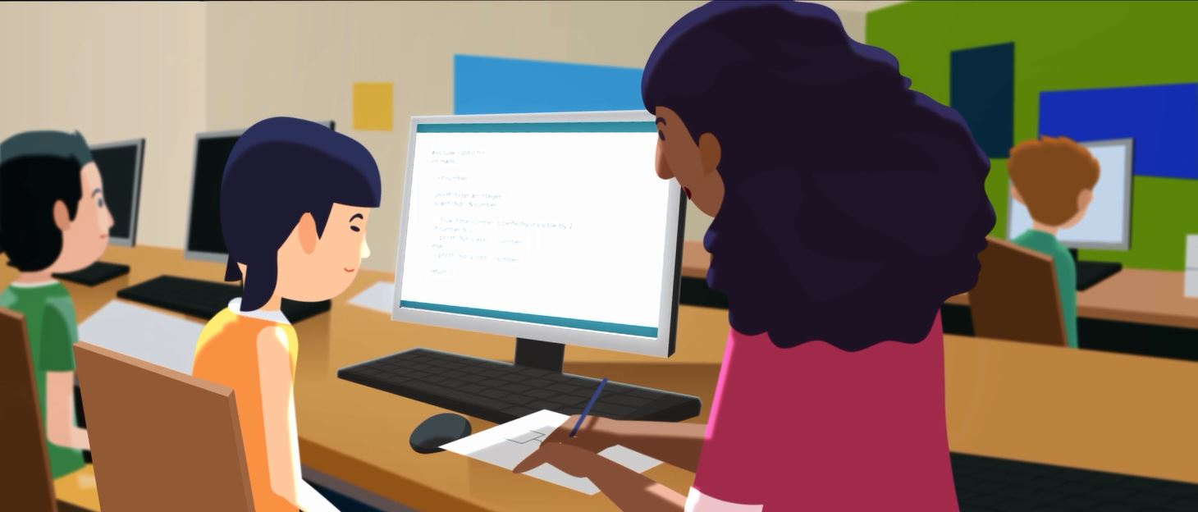
Feedback animation
Notes:
Purpose:
To share the feedback animation.
Facilitator notes:
Graphic is hyperlinked to the animation.
Key point:
Through the workshop there will be opportunity to unpack the ideas in the animation and to understand what you are currently doing well with regard to feedback and where you might focus your efforts.
Expected outcome:
Building on the definition from the previous slide, teachers will have a better understanding of the underpinning research, the three feedback questions and the key elements of effective feedback.
Estimated timing
5 minutes

Slide 7

Why should we focus on feedback in our school?
Notes:
Purpose:
To share the case for change (Reason for introducing this strategy) for enhancing feedback practices within your context, answering the question: Why should we focus on feedback in our school?
Facilitator notes:
The facilitator will need to determine if they will bring the case for change to the session or work with staff during the session to collaboratively identify the case for change.
Whether you develop the case for change with staff, or bring the case for change to the workshop, consider the need to work with staff to understand how the case for change aligns with student needs, school priorities, school assessment data, potential impact, evidence-based teaching and learning practices, and improvements and consistency in teaching practice.
If bringing the case for change to the session then remove the animation picture and add these to the slide as dot points.
Suggested activity:
Feedback case studies provide opportunity to see how and why other schools introduced a focus on feedback. This can stimulate reflection and discussion as you consider your own context and need.
To assist in selecting a case study to review and discuss, here is a list of identified needs:
to introduce a personalised learning approach underpinned by better use of data (See the following case study: Next steps in learning – Eastbourne Primary School)
to arrest and improve stagnant or declining student outcomes data (See the following case studies: Engaging staff in leading change – Richardson Primary School, Building a whole school approach – Woonona Public School, Workshop lesson structure and feedback - Woori Yallock Primary School and Explicit Teaching and feedback - South Halls Head Primary School)
as a key part of introducing a consistent school-wide pedagogical approach (See the following case studies: Explicit Teaching and feedback - South Halls Head Primary School, Building a whole school approach – Woonona Public School, Trialling feedback practices – Rosny College and Workshop lesson structure and feedback - Woori Yallock Primary School)
to reduce discrepancies between teacher assessments and external assessments of student performance (See the following case study: Workshop lesson structure and feedback - Woori Yallock Primary School).
Expected outcomes:
Teachers will:
identify priority issues that need to be addressed in their context
reflect on whether/how feedback might assist in dealing with these issues.
Estimated timing
20 minutes

Slide 8
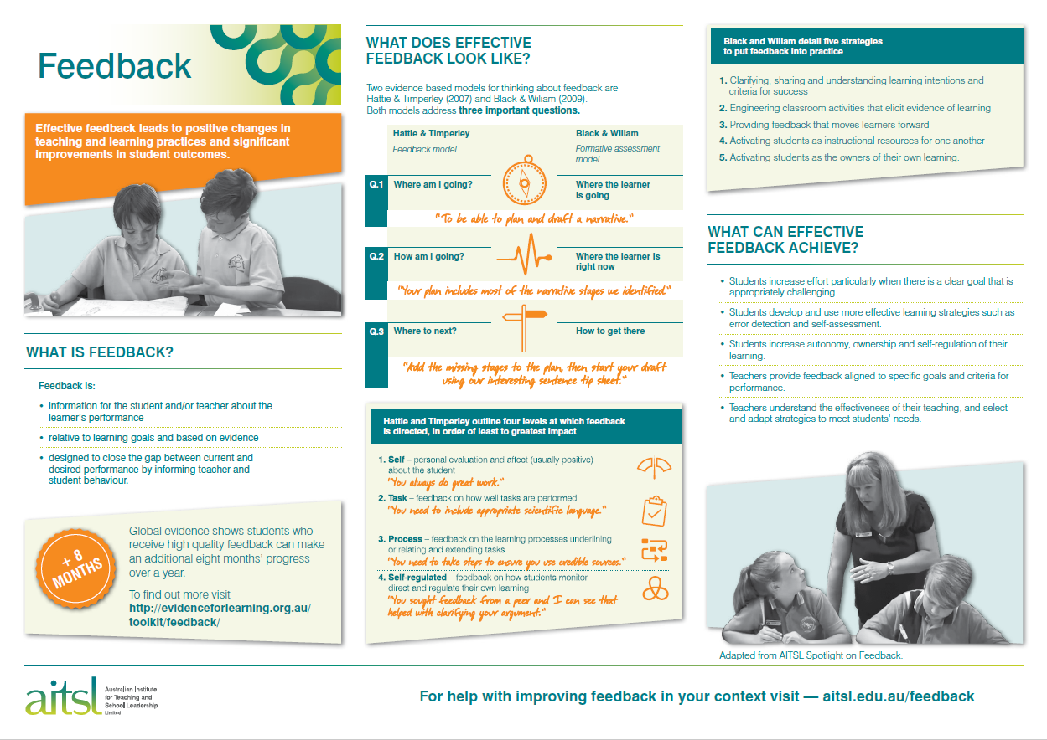
Factsheet
Notes:
Purpose:
To introduce the fact sheet as an overview of what has been covered to this point and as a lead into discussing the three feedback questions in more detail.
Facilitator notes:
Printed copies of the fact sheet will prove useful throughout the workshop.
Key points:
The fact sheet highlights the importance of the three questions underpinning feedback and of the benefits of effective feedback.
The three questions do not sit in isolation from one another, but rather overlap.
This is the first reference to the five strategies from Wiliam and Black and the levels of feedback from Hattie and Timperley. The levels will be addressed later in the slide deck.
Research:
Drawn from the AITSL Spotlight: Reframing feedback to improve teaching and learning available at www.aitsl.edu.au/feedback.
Expected outcome:
Teachers will understand the:
centrality of the three questions
key ideas around the five key strategies of Wiliam and Black and the levels of feedback from Hattie and Timperley.
Estimated timing
5 minutes

Slide 9


Q1: Where is the learner going?
Goals:
should be appropriately challenging
should ensure students know where they are headed
guide teachers in selecting teaching and learning activities
provide the basis for tracking progress and providing feedback
Practical techniques:
      Learning intentions and
      success criteria
      Rubrics
      Bump it up walls
Notes:
Purpose:
To present some of the research about this question and to highlight some useful practical techniques.
Facilitator notes:
This slide provides information about the research underpinning this question and practical techniques that teachers might use.
The practical techniques on the slide are explained below.
Sharing the explanations of the practical techniques will assist with the questions on the next slide.
Key points:
The task of feedback is to help students close the gap in performance. However, students can only identify the gap if they understand the goal of the teaching and learning.
An understanding of a student’s current level of knowledge and performance, based on evidence, is vital to setting appropriately challenging learning goals.
‘When goals have appropriate challenge and teachers and students are committed to these goals, a clearer understanding of the criteria for success is likely to be shared.’ (Hattie & Timperley, 2007, p. 89)
There is very good evidence that setting specific goals, often with criteria for a high quality performance on a task, effectively and significantly increases individual performance.
Practical techniques:
(Note that Learning intentions and success criteria are addressed in one of the feedback strategy documents. Refer to that document for more information that can support staff discussion.)
Learning Intentions are a description of what learners should know, understand and be able to do by the end of a learning period.
Learning intentions are the basis for selecting and evaluating teaching and learning activities, tracking student progress, providing feedback and assessing achievement.
Learning intentions need to be appropriately challenging.
Teachers need evidence of where students are in their learning to set appropriately challenging learning intentions.
If learning intentions are too easy or too hard they can lead to reduced effort and disengagement.
If students are committed to their goals, they are more likely to seek and receive feedback.
Success criteria are the measures used to determine whether and how well learners have met the learning goals.
They need to be clear and specific to avoid ambiguity.
Success criteria help teachers and students measure progress against their goals, and to know when students have achieved success in their learning.
Rubrics are guidelines for measuring achievement that state the learning intentions with clear performance criteria, a rating scale and a checklist. Ideally they are relevant to multiple tasks over a unit of learning.
A bump it up wall involves teachers sharing annotated work samples at different levels of quality on the wall in the classroom. The works samples are often rated against rubrics. Students are asked to review their work against the work samples to self-assess their performance and to determine how they might improve the quality of their work before sharing it with the teacher. Trialling feedback practices from Rosny college (02:15 – 03:11), Workshop lesson structure and feedback from Woonona Public School feedback case study (05:05 – 05:31), and Next steps in learning from Eastbourne Primary School case study(02:47 – 03:41).
The suggested practical techniques above can be used to answer more than one of the three feedback questions.
Research:
AITSL Spotlight: Reframing feedback to improve teaching and learning available at www.aitsl.edu.au/feedback.
Black, P, & Wiliam, D, 2010, ‘Inside the black box: Raising standards through classroom assessment’, Phi Delta Kappan, vol. 92, no. 1, pp 81-90.
Hattie, J & Timperley, H, 2007, ‘The Power of Feedback’, Review of educational Research vol. 77, no. 1, pp 81-112
Victorian Curriculum and Assessment Authority. http://www.insight.vic.edu.au/assessment-in-practice/shared-clarity-about-the-learning
Wiliam, D., 2015. ‘Embedding formative assessment’, Learning Science International. Pp 27-62.
Wiliam, D., 2010. ‘The role of formative assessment in effective learning environments’, The nature of learning: Using research to inspire practice, pp.135-155.
Expected outcomes
Teachers will:
understand why it is important to address the question of where the learner is going
understand what key elements need to be considered when answering this question
consider several practical techniques.
Estimated timing
10 minutes

Slide 10
Activity 2: Where is the learner going?
What are we currently doing to address this question with our students?
Could we adapt anything we currently do to clarify learning goals with students and to ensure goals are appropriately challenging?
Is there any practice that we are not currently doing but would like to start?
Notes:
Purpose:
To support participants to reflect on their current practice and to consider how they might further address the feedback question.
Facilitator notes:
The way these questions are addressed can be adapted to suit the group, e.g. whole or small group discussions, think-pair-share, individual post-it notes, etc...
If seeking to adapt an existing practice or introduce a new practice staff may need to access and share further information to ensure that they have a comprehensive understanding of what is required.
Key points:
Consider the local context and current practice and discuss what works best for you.
Expected outcomes:
Teachers will:
reflect on their practice and on ways to improve
become interested in trialling some of the techniques presented in the previous slide, or discussed by the group
plan to access and share further information, as required.
Estimated timing
20 minutes

Slide 11

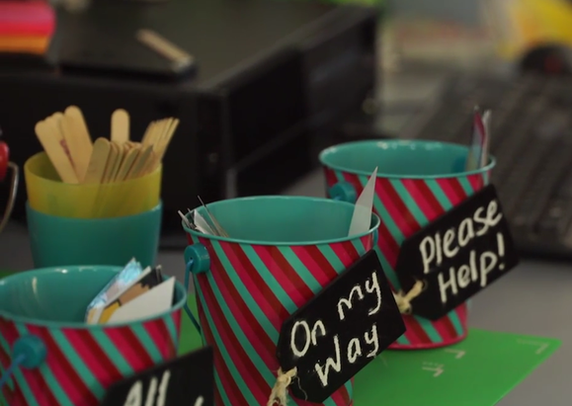
Q2: How is the learner going?
Evidence of student understanding and progress is required to:
  determine next steps in learning
  inform feedback that will progress learning
  assist teachers in evaluating the impact of their teaching and learning activities
Practical techniques:
      Individual whiteboards
      Exit slips
      Data walls
Notes:
Purpose:
To present some of the research about this question and to highlight some useful practical techniques.
Facilitator notes:
This slide provides information about the research underpinning this question and practical techniques that teachers might use.
The practical techniques on the slide are explained below, along with several extras.
Sharing the explanations of the practical techniques will assist with the questions on the next slide.
Key points:
A range of evidence can be used to understand where the student is in their learning including formal and informal assessment data and classroom activities that elicit understanding.
Evidence of student performance supports establishing appropriately challenging learning intentions and success criteria and planning teaching and learning activities appropriate to the learning goals.
Understanding where a student is in their learning and what their next steps in learning are is the basis for providing feedback designed to progress learning.
Teachers can use evidence of student understanding and progress to evaluate the impact of their chosen teaching and learning activities and to adapt if necessary, to meet the needs of their students.
Practical techniques
Individual whiteboards - A quick assessment of student understanding. Teachers ask students questions and students record their answers on individual whiteboards. Students then hold up their whiteboards, providing the teacher with information regarding individual and whole class understanding. In addition, students can be asked to answer questions on their whiteboard, with the teacher moving through the class observing their approach and answers.
Exit slips - At the conclusion of a lesson students are asked to write down a comment about their learning, often on a sticky note. Students can be asked to comment on what they found difficult, what they would like more information about or what they have learnt in the lesson. The information can then be used by the teacher to plan further lessons and to gauge when students are ready to move to the next stage of learning. See feedback case study Building a whole school approach from Woonona Public School (06:42 – 07:28)
Data walls - A display of students’ progress in the classroom. Teachers share students’ learning goals, and their progress towards their goals on a wall, so that it is visible to students and the teacher. See feedback case studies - Next steps in learning - Eastbourne Primary School and Workshop lesson structure and feedback from Woori Yallock Primary School.
Red, green, amber cups - Students use coloured cups to indicate their level of understanding. They place a red cup on their table to indicate that they are struggling to understand the work and that they need help. The amber cup signals that help is needed, however it’s not urgent. The green cup shows they understand and do not need assistance.
Thumbs up or down - Students indicate whether they understand the instructions or concepts by holding thumbs up if they do, and thumbs down if not. Students can angle their thumbs to show different degrees of understanding.
Research:
AITSL Spotlight: Reframing feedback to improve teaching and learning available at www.aitsl.edu.au/feedback.
Black, P, & Wiliam, D, 2010, ‘Inside the black box: Raising standards through classroom assessment’, Phi Delta Kappan, vol. 92, no. 1, pp 81-90.
Hattie, J & Timperley, H, 2007, ‘The Power of Feedback’, Review of educational Research vol. 77, no. 1, pp 81-112.
Wiliam, D., 2015. ‘Embedding formative assessment’, Learning Science International. Pp 63 - 101.
Wiliam, D., 2010. ‘The role of formative assessment in effective learning environments’, The nature of learning: Using research to inspire practice, pp.135-155.
Expected outcomes
Teachers will:
have a better understanding of the research base behind this question
understand why it is important to address the question of how is the learner going
understand what key elements need to be considered when answering the question
consider several practical techniques.
Estimated timing
15 minutes

Slide 12
Activity 3: How is the learner going?
What are we currently doing to collect evidence of student progress? How are we using this evidence to inform feedback and lesson planning?
Could we adapt anything we are currently doing to better understand our students’ progress?
Are there some practical techniques that we could trial in our context?
Notes:
Purpose:
To support participants to reflect on their practice.
Facilitator notes:
The way these questions are addressed can be adapted to suit the group, e.g. whole or small group discussions, individual post-it notes, etc...
Key points:
Think of the local context and current practice and discuss what might work best for your site.
Expected outcomes:
Teachers will:
reflect on their practice and on ways to improve
become interested in trialling some of the techniques presented in the previous slide, or discussed by the group
plan to access and share further information, as required.
Estimated timing
20 minutes

Slide 13


Q3: How to get there?
Effective feedback is:
  goal referenced, specific, corrective, constructive and timely
  focused on effort, task, process or self-regulation
Practical techniques:
      Conferencing
      Peer feedback
      Audio feedback
Notes:
Purpose:
To present some of the research about this question and to highlight some useful practical techniques.
Facilitator notes:
This slide provides information about the research underpinning this question and practical techniques that teachers might use.
The practical techniques on the slide are explained below, along with several extras.
Sharing the explanations of the practical techniques will assist with the questions on the next slide.
A Peer feedback strategy document is available as part of the feedback resources and can be used to support staff discussion about this technique. This is available at www.aitsl.edu.au/feedback.
Key points:
It is essential to provide feedback on how to progress towards goals in order to maximise the possibilities for learning and make sure that the learner is on the right track.
Sometimes students learn something different than what we intended for them to learn. In these cases we need to provide feedback that gets them back on track.
See the feedback Spotlight (p 8) for a summary of effective and ineffective feedback practices, drawn from the evidence-base.
Teachers should avoid praising students’ achievement or intelligence as this can lead to a fixed mindset and remove the focus from the learning process.
After providing feedback, teachers need to follow up and ensure that students are acting on the feedback they are given.
Practical techniques:
Conferencing – provides opportunity for teachers to work one-on-one with their students. Teachers spend time with each student addressing current understanding, providing feedback on where to next and gathering data on students learning to shape their teaching. See feedback case studies - Next steps in learning - Eastbourne Primary School and Workshop lesson structure and feedback - Woori Yallock Primary School.
Peer feedback - Students can use success criteria, such as rubrics, to guide the feedback that they provide to their peers. See the peer feedback strategy for guidance on effective peer feedback practices, what to consider when introducing this into the classroom and links to further information. Also, see feedback case studies Building a whole school approach from Woonona Public School (03:15 – 04:13), Next steps in learning from Eastbourne Primary School (03:55 -04:35), and Explicit teaching and feedback from South Halls Head Primary School (04:04 – 04:42).
Audio feedback – teachers can record their feedback comments using a range of audio tools, as they are going over student work. Students are then able to listen to the comments as they review their work and to go back to the comments in future.
Research:
AITSL Spotlight: Reframing feedback to improve teaching and learning available at www.aitsl.edu.au/feedback.
Black, P, & Wiliam, D, 2010, ‘Inside the black box: Raising standards through classroom assessment’, Phi Delta Kappan, vol. 92, no. 1, pp 81-90.
Faulkner, N. 2011, ‘How to maximise student learning after assessment whilst minimising the pain of correction’, English in Australia, Vol 46 no 3.
Hattie, J & Timperley, H, 2007, ‘The Power of Feedback’, Review of educational Research vol. 77, no. 1, pp 81-112
Wiliam, D., 2015. ‘Embedding formative assessment’, Learning Science International. Pp 103 - 137.
Wiliam, D., 2010. ‘The role of formative assessment in effective learning environments’, The nature of learning: Using research to inspire practice, pp.135-155.
Expected outcomes:
Teachers will:
have a better understanding of the research base behind this question
understand why it is important to address the question of how to get there
understand what key elements need to be considered when answering the question
have a better understanding of effective feedback.
Estimated timing
15 minutes

Slide 14
Activity 4: How to get there?
How are we currently providing feedback to help our students understand how to progress towards their goals?
Could we adapt what we are currently doing to enhance the quality of feedback to our students?
Are there some practical techniques that we could trial in our context?
Notes:
Purpose:
To support participants to reflect on their practice.
Facilitator notes:
The way these questions are addressed can be adapted to suit the group, e.g. whole or small group discussions, individual post-it notes.
Key points:
Think of the local context and current practice and discuss what works best for you.
Expected outcomes:
Teachers will:
reflect on their practice and on ways to improve.
become interested in trialling some of the techniques presented in the previous slide, or discussed by the group
plan to access and share further information, as required.
Estimated timing
20 minutes

Slide 15




Hattie & Timperley’s four levels of feedback
Task feedback
Process feedback
Self-regulation feedback
Self feedback
Notes:
Purpose:
To provide greater detail of the four levels of feedback.
Key points:
Hattie and Timperley provide four levels of feedback that are relevant to the teacher and student and to each of the three feedback questions outlined in the previous slides.
The first three types of feedback listed on the slide are in order of potential impact
Self-level feedback, the final level noted on the slide, is ineffective and this is covered further in slide 17 on Praise for effort.
The levels of feedback are included on the feedback Fact Sheet.
The levels are as follows:
Task level:
Information on how well a task is being accomplished such as, distinguishing correct from incorrect answers, or directing students to acquiring further information.
It is more powerful when it deals with faulty interpretations, not lack of information. This feedback can address correctness, neatness, behaviour or some other criterion related to task accomplishment.
“A surface understanding of learning involves the acquisition, storing, reproduction, and use of knowledge and thus relates more to [task feedback].” (Hattie and Timperley, 2007, p93)
Process level:
“Specific to the processes underlying tasks or relating and extending tasks” (Hattie and Timperley, 2007, p93)
A key focus is students’ strategies for error detection.
“Using process feedback with goal setting appears to be a direct and powerful way of shaping an individual’s task strategy” (Early et al. cited in Hattie and Timperley, 2007, p93)
It is more effective than task level in enhancing deeper learning.
Self regulation:
“Addresses the way students monitor, direct and regulate actions toward learning goals. It implies autonomy, self-control, self-direction, and self-discipline.” (Hattie and Timperley, 2007, p.93)
“Effective learners create internal feedback and cognitive routines while they are engaged in academic tasks” (Hattie and Timperley, 2007, p.94)
Hattie and Timperley cite Paris & Winegrad (1990) in noting there are two aspects to self-assessment: “self-appraisal: relates to students’ facility to review and evaluate their abilities, knowledge and cognitive strategies through a variety of self-monitoring processes. Self-management: monitoring and regulation of students’ ongoing behaviour through planning, correcting mistakes and using fix-up strategies.” (Hattie and Timperley, 2007, p.94)
Self feedback:
Self-feedback is personal feedback about the student. For example, ‘You are very smart’ or ‘Great effort’.
“It usually contains little task-related information and is rarely converted into more engagement, commitment to the learning goals, enhanced self-efficacy, or understanding about the task.” (Hattie and Timperley, 2007, p.96)
Praise addressed to students is unlikely to be effective because it carries little information on the learning task or process, or any of the three questions. It deflects attention from the task. (Hattie and Timperley, 2007, p.96)
Research:
Hattie, J & Timperley, H, 2007, ‘The Power of Feedback’, Review of educational Research vol. 77, no. 1, pp 81-112
Expected outcomes:
Teachers will:
have an appreciation that there are different types of feedback
understand how feedback can be classified with reference to Hattie and Timperley’s levels of feedback.
Estimated timing
10 minutes

Slide 16
Activity 5 – Four levels of feedback
24hrs
Notes:
Purpose:
For teachers to understand the levels of feedback they provide in a typical day.
Key points:
It’s important to reflect on what we currently do if we want to improve the range of feedback levels we are offering our students.
After the activity, draw out any patterns in the responses and discuss any strengths/limitations that are revealed. e.g. if task feedback is most prevalent, feedback practices could be enhanced for greater effect with a revised focus on process and self-regulation. If there are several examples placed in the self level, and focus on praise of intelligence/talent, connections to the following slide (Carol Dweck video) can be made.
Activity notes:
Individually, participants write down examples of feedback they have provided to their students (or supported their students to experience) over the last 24 hours.
One example per post-it note.
Label a wall/whiteboard with the four levels of feedback. Ideally this is in a quadrant to allow for some ‘middling’ of responses.
Participants then place their post-it notes on the corresponding section of the quadrant.
Discuss any patterns or surprises with the group.
Materials required:
Post-it notes.
Expected outcomes:
Teachers will:
have opportunity to further discuss and clarify the levels of feedback
have a better understanding of the levels of feedback they typically provide
identify any trends across the school in levels of feedback
consider how they might try to provide feedback at different levels.
Estimated timing
20 minutes

Slide 17
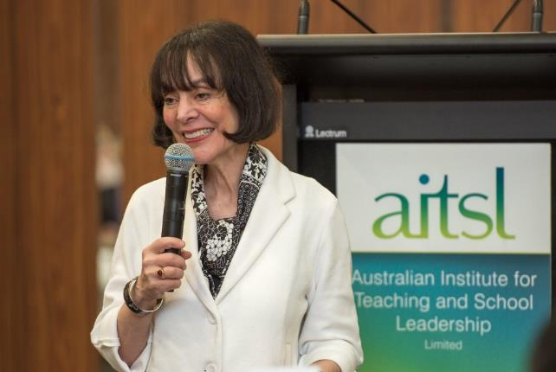
Praise for effort
“…to foster a growth mindset among students, we need to praise their efforts.”
Carol Dweck
Notes:
Purpose:
To provide an overview of Carol Dweck’s findings around praise for intelligence/talent compared with praise for process/effort.
Facilitator notes:
The image is hyperlinked to the video - https://www.youtube.com/watch?v=hiiEeMN7vbQ
Further information is provided in the feedback Spotlight on page 9.
Draw on some of the responses from the activity in the previous slide, particularly to ‘self’ feedback, to assist with reflection on praise.
The next slide provides an activity focussed on the growth mindset.
Key points:
Praise for intelligence and talent can push students away from learning and growth, and makes them vulnerable to a fixed mindset.
Praising effort, process, strategy and progress build students’ resilience and creates greater confidence and persistence – supporting a growth mindset.
Research
AITSL Spotlight: Reframing feedback to improve teaching and learning available at www.aitsl.edu.au/feedback.
Dweck, C.S 2007, ‘The perils and promises of praise’, ASCD, vol. 65, no. 12, pp. 34-39.
Dweck, C 2017, Mindset-Updated Edition: Changing The Way You think To Fulfil Your Potential, Hachette, UK.
Expected outcomes:
Teachers will:
develop a better understanding of the perils of praising fixed traits in students such as intelligence and talent.
Estimated timing
10 minutes

Slide 18
Activity 6: Praise for effort
Need to know…
Worried about…
Excited about …
Support needed …
Notes:
Purpose:
To provide an opportunity to reflect on and discuss the fixed and growth mindsets and how a growth culture can be enhanced in your context.
Facilitator notes:
To encourage staff to reflect on Carol’s presentation you can run a NEWS activity as a way of collectively understanding how you can foster a growth mindset within your context.
This activity can help to clarify what further information is needed to help staff foster a growth mindset within classrooms and across the school.
Suggested activity:
Place four posters around the room with one of the following titles on each:
Need to know… (What more do I need to know in order to understand this concept?)
Excited about… (What excites me about this work and how it might connect to my teaching?)
Worried about… (What worries me about focusing on the growth mindset?)
Support required…. (What support do I need in order to introduce a growth mindset into my classroom?)
Give staff a few minutes to address each of these on post-it notes and to attach the post-it notes to the appropriate posters.
Ask staff to try to group similar ideas or themes together as they attach their notes.
Use the notes on each poster to address one or more of the following:
share ideas and themes back to the group
discuss key ideas and themes as a group
use the information to plan future professional learning for staff
coordinate staff in taking action to gather and share further information about the growth mindset to assist them in taking action.
Expected outcomes:
Teachers will:
reflect on the types of praise they give their students and its potential impact.
develop a better understanding of the perils of praising fixed traits in students such as intelligence and talent
plan to access and share further information, as required.
Estimated timing
20 minutes

Slide 19

Practice-centred collaboration
Notes:
Purpose: To understand the importance of collaboration in supporting teachers to develop knowledge and to enhance feedback practices.
Facilitator notes:
The importance of teachers working collaboratively to build knowledge and enhance feedback practices is evident through each of the feedback case studies and is supported by research.
This slide can he used to simply affirm the need for collegial support in implementation or to support staff in reviewing and strengthening current practices.
The Professional Learning Communities strategy included in the feedback resources provides evidence based advice on how to establish and sustain PLCs and also provides links for finding out further information.
The PLC strategy is a useful resource as you refine, refocus or establish collaborative meeting opportunities. The strategy is available at www.aitsl.edu.au/feedback.
Key points:
Heitink et al. note teachers need support to introduce new teaching strategies, effective feedback practices and effective questioning and that practice-centred collaboration is “an important means for facilitating this kind of support” (Heitink, et al., 2016, p58)
“Teachers need to engage in conversations with colleagues about formative assessment and teaching, and collaborate on shared problems and dilemmas.” (Heitink, et al., 2016, p58)
It is important to identify opportunities for teachers to work collaboratively and to ensure that the collaborative opportunities are leading to the desired change.
Suggested activity:
Provide copies of the Professional Learning Communities strategy document to staff.
In groups have staff review the PLC strategy document and then reflect on their current opportunities to collaborate - identifying strengths and areas for improvement.
Have staff brainstorm and then refine a list of possible actions to enhance their collaborative opportunities and collegial support, as they focus on feedback.
Staff may also plan to look into some of the suggested links in the PLC strategy document and to share this information at a future meeting.
Research:
AITSL Spotlight: Reframing feedback to improve teaching and learning available at www.aitsl.edu.au/feedback.
Heitink, M, Van der Kleij, F, Veldkamp, B, Schildkamp, K & Kippers, W, 2016, ‘A systematic review of prerequisites for implementing assessment for learning in classroom practice’, Educational Research Review, vol. 17, pp. 50-62.
Expected outcomes:
Teachers will:
have opportunity to reflect on and consider current opportunities for collaboration
agree actions to enhance their opportunities for collaboration
know where they can access supporting resources
Estimated timing
20 minutes (With suggested activity)

Slide 20
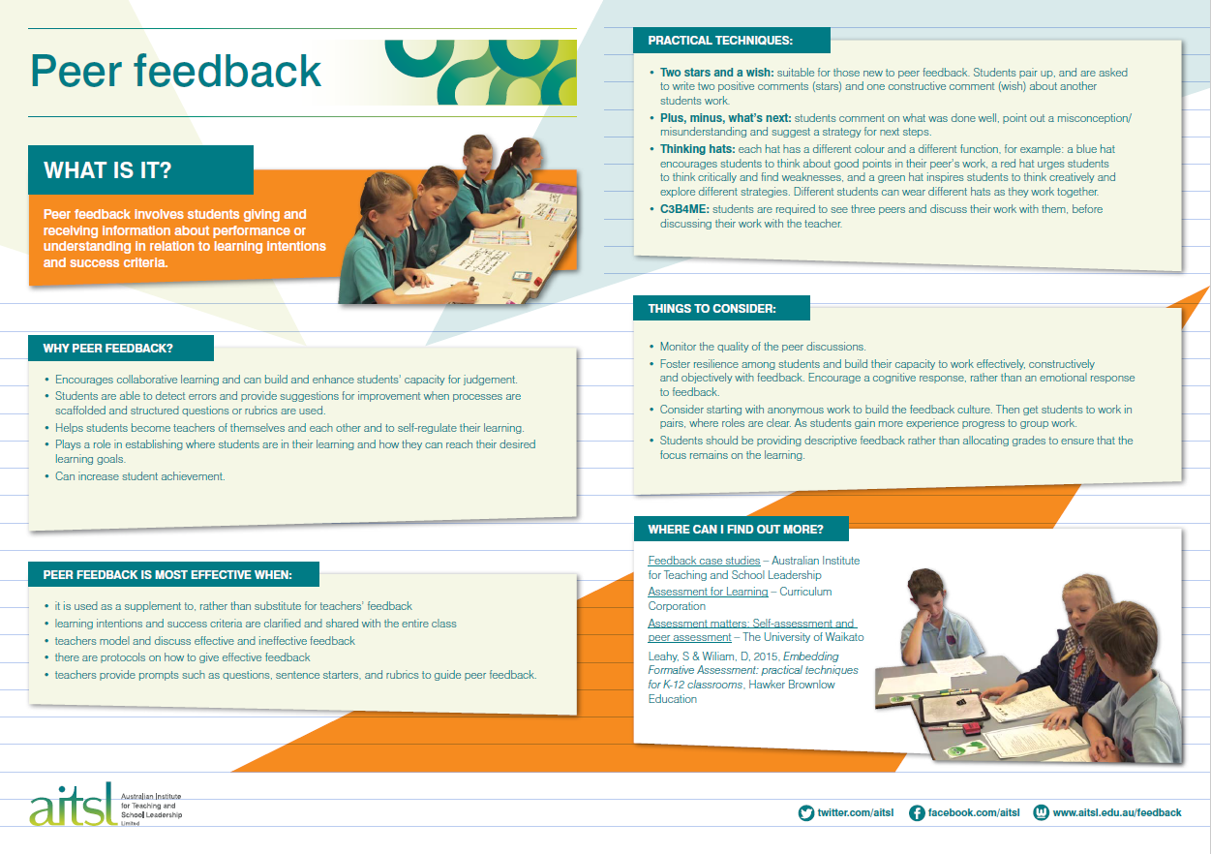

Feedback strategies in the classroom
Notes:
Purpose: To understand the range of supports available on the AITSL website to help understand and implement feedback strategies
Key points:
There are a number of evidence-based strategies that support effective feedback taking place.
Resources on the AITSL website include:
Feedback strategy overviews on:
Peer Feedback
Professional Learning Communities
Learning Intentions and Success Criteria.
Video and written case studies demonstrating and explaining a range of feedback practices.
Demonstrate to staff where the resources are located on AITSL’s site – http://www.aitsl.edu.au/feedback
Materials required:
Handouts if required.
Expected outcomes:
Teachers will:
know where they can access supporting resources
have greater confidence in trialling one or more of these strategies.
Estimated timing
2 minutes

Slide 21
Activity 7: Building student capability
“Feedback should be creating a cognitive response not an emotional reaction. That’s what we want the feedback to do.” Richardson Primary School
What skills do our students need to:
  listen to and understand feedback?
  use feedback?
  provide feedback?
What activities will help our students build these skills?
Notes:
Purpose:
To gain a shared understanding of the skills students need to develop to participate in effective feedback practices.
Key points:
Students need to be brought on the journey of implementing feedback practices with you.
There is a need to identify the skills in which your students will need scaffolding.
Building resilience in students to work with feedback will take time.
For more information, see feedback case studies Engaging staff in leading change – Richardson Primary School and Explicit Teaching and feedback - South Halls Head Primary School.
Activity notes:
In small groups, spend 5-10 minutes on each question. Record suggestions on post-it notes for consolidation and sharing when the group come back together.
Seek agreement on the skills and the activities to be trialled by teachers.
Materials required:
Post-it notes.
Expected outcomes:
Teachers will:
agree on the need to scaffold students’ skills in feedback
have practical ideas for scaffolding these skills.
Estimated timing
30 minutes

Slide 22
Activity 8 – Enablers and barriers
Notes:
Purpose:
To gain a shared understanding of the enablers and barriers to implementing changed feedback practices.
Key points:
There are a range of structures, skill levels, processes, policies, etc… that will help or hinder implementing feedback practices.
It is important to consider these, and address the barriers and capitalise on enablers where possible.
Domitrovich et al., note examples of barriers and enablers to implementation that might help to start the discussion:
strong leadership support can influence willingness to try interventions and their efficacy
when new practices are aligned to school policies, improvement processes and strategic planning, they are more likely to be prioritised and implemented with quality
involving teachers in decision making about new work can decrease resistance
if consideration is not given to how the new work fits into current structures and routines, teachers can experience burden and stress which impacts implementation.
Research:
AITSL Spotlight: Reframing feedback to improve teaching and learning available on the feedback page of the AITSL website.
Domitrovich, C E, Bradshaw, CP, Poduska, JM, Hoagwood, K, Buckley, JA, Olin, S, Romanelli, LH, Leaf, PJ, Greenberg, MT & Ialongo, NS 2008), ‘Maximizing the implementation quality of evidence-based preventive interventions in schools: A conceptual framework.’, Advances in School Mental Health Promotion, vol. 1, no. 3, pp. 6-28
Activity notes:
Nominate groups to focus on either enablers or barriers. Spend 5-10 minutes listing the enablers or barriers on the left side of an A4 piece of paper.
Groups swap papers with an opposite group and discuss/record possible ways to capitalise on enablers and mitigate or remove barriers.
Ask for some ideas to be shared with staff.
Materials required:
A4 paper
Expected outcomes:
Teachers will:
consider the enablers and barriers
have practical ideas for mitigating barriers and capitalising on enablers.
School leaders will:
have useful information on perceived enablers and barriers for implementing feedback.
Estimated timing
25 minutes

Slide 23
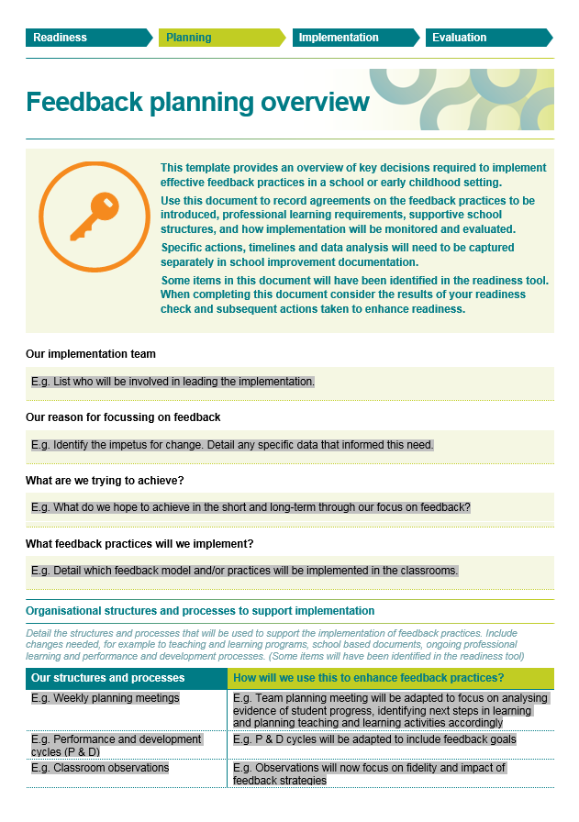
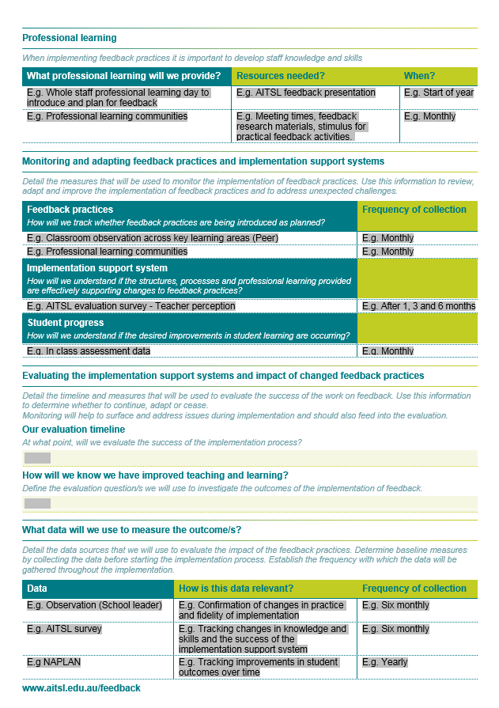
Planning for action
Notes:
Purpose:
To begin discussion or raise awareness on implementation actions, determining what success looks like, and evaluating implementation.
Facilitator notes:
Drawing on the learnings highlighted in the workshop to date (evidence base, feedback strategies, barriers and enablers), you can begin planning actions and defining success.
The Feedback Planning Overview document available on the AITSL website can help effective planning for implementation. http://www.aitsl.edu.au/feedback
Depending on the context, the facilitator may wish to provide a populated Planning overview for staff and ask for feedback/additions or start with an empty template and run this as an activity to begin discussion and gather information for each of the key considerations.
The Evaluating Impact document available on the AITSL website can help inform thinking on evaluation
Key points:
Evidence-based practices are unlikely to take hold within a school unless there is a clear implementation plan.
Crucial to the success of implementation is ensuring that you have established an evaluative framework in which to measure the impact of the change.
The Planning overview will assist you in recording key decisions about planning, monitoring changes in practice and evaluating impact.
Expected outcomes:
Teachers will understand:
that changing practice will happen in phases and over time
what they will likely try and when
what successful implementation will look like over time
that there will be a focus on monitoring and understanding the impact of the changes introduced.
Estimated timing
10 - 60 minutes depending on activities used.

Slide 24

Next steps
Notes:
Purpose:
To remind staff why the change is being sought.
Facilitator notes:
If possible, replace the animation with photos from your own school.
Key points:
Ensure staff are aware that the motivation behind the change is to improve student outcomes.
Outline next steps so that these are clear to staff.
Allow for questions.
Expected outcome:
Teachers will leave with a sense of optimism and practical strategies about changing their practice in feedback.
Estimated timing
8 minutes

