Slide 1
Australian Teacher Performance and Development Framework
An effective performance and development cycle
Notes:
Purpose
To familiarise the Australian education community with the Australian Teacher Performance and Development Framework.
To emphasise the processes and essential elements contained within the performance and development cycle.
To explore the components of an effective performance and development cycle.
To explore the Essential Elements of a cycle which should be present in all schools for all teachers.
Key points to share
AITSL has collaborated with education stakeholders to develop the Australian Teacher Performance and Development Framework.
Through national consultation on implementation the conversation in education has begun to build on creating a culture that values the performance and development of teachers, and generation of an effective environment for the implementation of effective teacher performance and development practices across the nation.
The Framework recognises that schools operate in different contexts and will be at different starting points, and the implementation of these essential elements will look different in different contexts. The pace and method of implementation of the Framework will be determined by jurisdictions, sectors and schools.
Expected outcomes
Build a shared understanding of effective approaches to teacher performance and development cycle processes to improve outcomes for all young Australians.
Materials required
All resources are available at http://www.newsroom.aitsl.edu.au/blog/framework-support-materials
All participants will require copies of:
Australian Teacher Performance and Development Framework (the Framework).
The presentation will be enhanced if participants have access to the following additional Framework resources:
The Framework Discussion Wheel – printable desktop stimulus resource
The Framework Activity Cards – stimulus questions to generate discussion
The Framework Fact Sheet – Animation style
The Framework Infographic – Animation style
The Framework Frequently Asked Questions.
Companion documents :
Australian Professional Standards for Teachers (the Standards)
Australian Professional Standard for Principals (the Standard)
Australian Charter for the Professional Learning of Teachers and School Leaders (the Charter).

Slide 2

Australia aims to be a world leader in education
Notes:
(Note to facilitator: this slide features in all of the Framework workshop presentations so you may choose to leave it out if you are utilising all of the presentations.)
Purpose
To highlight that Australia is positioning itself to be a world leader in education.
Key points to share
The Melbourne Declaration on Educational Goals for Young Australians makes clear that Australia aspires not to be among the best in the world, but to be the best. It acknowledges the challenges and opportunities of the 21st century and provides two simple, but powerful, goals to guide Australian education:
Goal 1: Australian schooling promotes equity and excellence.
Goal 2: All young Australians become:
successful learners.
confident and creative individuals.
active and informed citizens.
The national education reform agenda has resulted in the following policies which demonstrate a consistent approach in all jurisdictions for all teachers across the country including, but not limited to, the following:
Australian Professional Standards for Teachers
Australian Professional Standard for Principals
Accreditation of Initial Teacher Education Programs in Australia: Standards and Procedures
Nationally Consistent Registration of Teachers in Australia
Certification of Highly Accomplished and Lead Teachers in Australia
Australian Teacher Performance and Development Framework
Australian Charter for the Professional Learning of Teachers and School Leaders
National Plan for School Improvement
The Australian Curriculum
National Quality Framework for Early Childhood Education and Care
Early Years Learning Framework and National Quality Standard.
Research
‘Over the next decade Australia should aspire to improve outcomes for all young Australians to become second to none amongst the world’s best school systems’ (MCEETYA 2008, p 5).
‘Together, all Australian governments commit to working with all school sectors and the broader community to achieve the educational goals for young Australians’ (MCEETYA 2008, p. 10).

Slide 3
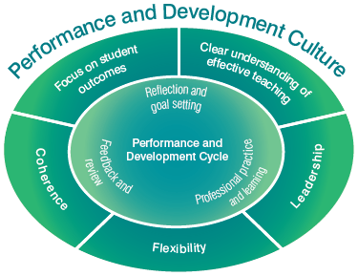
Performance and development culture
Focus on student outcomes
A clear understanding of effective teaching
Leadership
Flexibility
Coherence
Notes:
Purpose
To focus on where the cycle and essential elements fit within a performance and development culture.
Key points to share
A focus on student outcomes - Improving teaching is not an end in itself. It is directed at improving outcomes for students. The Framework defines student outcomes broadly to include student learning, engagement in learning and wellbeing, and acknowledges that these can be measured in a variety of ways.
A clear understanding of effective teaching – The Australian Professional Standards for Teachers outline what teachers should know and be able to do at four career stages. The Standards should be seen as providing the basis and a common language for coming to a shared understanding of what effective teaching looks like in the context of a particular school at a particular time.
Leadership - Research is clear on the critical role of leaders in creating a culture of performance and development. While it is acknowledged that principals have a central role, a performance and development culture cannot be driven by one person alone. A truly effective approach is characterised by a shared commitment to improvement and an acceptance that teachers have a powerful role to play in each others’ development, as well as their own.
Flexibility - All schools are different, and need to respond to their unique contexts and histories. Schools vary widely in their existing approaches to teacher performance and development. The draft Framework describes the elements of an effective approach to teacher performance and development, but acknowledges that these elements will look different in each school.
Coherence – Performance and development processes and teacher goals should reflect the overall approach to teaching and learning within a school, and should be consistent with the school plans. Alignment to school plans and school-wide approaches to professional learning are particularly important.
Formal performance and development procedures are important, but excessive attention to process is a common feature of less successful approaches. It is therefore important to focus on the factors that need to be in place for a performance and development culture to flourish and to situate the cycle within the performance development culture.
Research
‘To introduce and sustain an effective school-based performance and development system, a culture must exist among school leaders and teachers that is open to feedback and serious about performance and development—that is, a culture that sees performance management as much more than ticking boxes and development as much more than gaining credentials. The need for such a culture to exist makes it very difficult simply to impose a performance and development system from the centre, however close such a system might be to best practice‘ (Kamenar, L 2012, p. 5).
‘Our research suggests that human resources–such as openness to improvement, trust and respect, teachers having knowledge and skills, supportive leadership and socialisation–are more critical to the development of professional community than structural conditions’ (Kruse, S et al 1994, p. 6).
Materials required
Read pages 3-4 of the Framework.

Slide 4
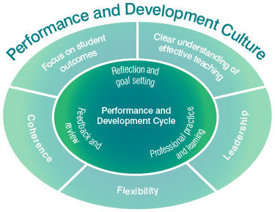
Performance and development cycle
This cycle provides a focus for appraising, developing and refining teaching and recognising the entitlements of teachers to receive feedback and support.
Notes:
Purpose
To introduce the performance and development cycle outlined in the Australian teacher Performance and Development Framework.
Key points to share
Performance and development occurs in a cycle which provides a focus for appraising, developing and refining teaching and recognising the entitlements of teachers to receive feedback and support.
Elements of the cycle are interwoven, will not necessarily occur in order and may take more or less time depending on circumstances.
However, the cycle provides a useful way of thinking about the process, and assists in identifying its important elements.
While the essential elements are necessary, they will not by themselves be sufficient to gain the maximum benefit from this process. However, it is important to be clear about common requirements and the minimum level of support that all teachers can expect in Australian schools.
Research
‘All studies show that the key to higher performing students is the effectiveness of their teachers. Conservative estimates suggest that students with a highly effective teacher learn twice as much as students with a less effective teacher. Systems of teacher appraisal and feedback that are directly linked to improved classroom teaching and student performance can increase teacher effectiveness by as much as 20 to 30%. This would lift the performance of Australia’s students to the best in the world’
(Jensen, B & Reichl, J 2011, p. 6).

Slide 5
Teacher performance
Teacher performance improves when these opportunities are available:
self-reflection and goal setting
regular classroom observation
provision of constructive feedback from school leaders and peers
frequent feedback on classroom performance
shadowing and coaching from peers and leaders
opportunities to engage in teamwork, collaboration and action learning
  Hay Group 2012, Growing our potential
Notes:
Purpose
To highlight that teacher performance will benefit from the processes outlined in the performance and development cycle.
Key points to share
The Framework highlights what is required to build a comprehensive and effective approach to high performance and development.
It outlines the characteristics of a successful system and the culture that needs to be in place for sustained improvements to occur in schools.
Research is unambiguous in showing that a successful approach to effective performance and development relies on creating a strong and supportive culture in a school.
Formal performance and development procedures are important but excessive attention to process is a common feature of less successful approaches. It is therefore important to focus on the factors that need to be in place for a performance and development culture to flourish.

Slide 6
Essential elements for effective performance and development
All teachers…
Set performance and development goals
Are supported in working towards their goals
Collect evidence to reflect on and evaluate
Receive feedback, including formal review
Notes:
Purpose
To introduce the essential elements of a performance and development cycle.
Key points to share
Whilst the essential elements of the cycle are necessary, they will not by themselves be sufficient to gain maximum benefits from this process.
Key points to share
The Framework contains four essential elements that are derived from research and existing effective practice in Australian schools.
It is intended that the essential elements are common requirements and present in all Australian schools.
Performance and development cycle:
Reflection and goal setting
Essential element: All teachers have a set of documented and regularly reviewed goals related to both performance and development, and ways of measuring progress towards them, that are agreed with the principal or delegate.
Professional practice and learning
Essential element: All teachers are supported in working towards their goals, including through access to high quality professional learning.
Essential element: Evidence used to reflect on and evaluate teacher performance, including through the full review described below, should come from multiple sources and include as a minimum: data showing impact on student outcomes; information based on direct observation of teaching; and evidence of collaboration with colleagues.
Feedback and review
Essential element: All teachers receive regular formal and informal feedback on their performance. This includes a formal review against their performance and development goals at least annually, with verbal and written feedback being provided to the teacher.
Materials required
Read the essential elements in pages 5 - 7 of the Framework.

Slide 7
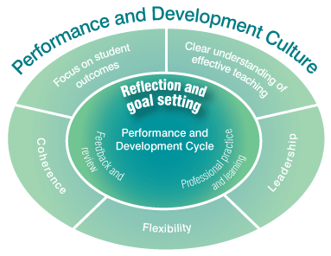
Reflection and goal setting
All teachers have a set
of documented and
regularly reviewed goals
related to both
performance and
development.
Notes:
Purpose
To introduce the reflection and goal setting component of the performance and development cycle.
Key points to share
The cycle begins with reflecting and setting goals. To engage purposefully in performance appraisal and development a teacher, with the support of the principal or delegate, must clearly articulate agreed goals based on the school’s shared view of effective teaching, derived from the Australian Professional Standards for Teachers.
These will include goals related to a teacher’s impact in and beyond the classroom:
Goals should take into account the teacher’s own reflection on their teaching practice informed by evidence and feedback, the school strategic plan, and goals or priorities set by, and for, teams of teachers within the school
Goals should be designed to be measurable and should have a clear link to the types of evidence to be used as a basis for feedback and reflection
A teacher’s goals should be regularly reviewed and adjusted as circumstances change
Goals should address both teacher performance and teacher development.
Essential element: All teachers have a set of documented and regularly reviewed goals related to both performance and development, and ways of measuring progress towards them, that are agreed with the principal or delegate.
Research
‘The more principals encourage self-reflection, the more teachers appreciate their feedback and the better the teaching becomes’ (Jensen, B & Reichl, J 2011, p. 15).
Australian teachers who report greater levels of self-efficacy in their role as teachers receive more frequent evaluation and feedback about their work, are more likely to have innovative teaching practices emphasised in their evaluations, and receive public recognition from principal/colleagues following evaluation of their work (OECD, 2009).

Slide 8
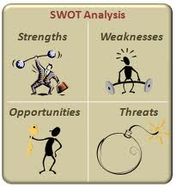
Activity: Self-reflection - SWOT
Notes:
Purpose
To have participants reflect on their teaching practice.
Key points to share
Goals should take into account the teacher’s own reflection of their teaching practice.
A SWOT (Strengths, Weaknesses, Opportunities, Threats) analysis can uncover your strengths and weaknesses (challenges) and the opportunities and threats facing you.
Taken together, your strengths and opportunities help you to identify potential goals. Your weaknesses and the threats you face are things that need to be managed, mitigated or planned for to ensure your goals remain achievable.
Duration
15 minutes.
Materials required
Activity – Self-reflection – SWOT stimulus questions
Activity – Self-reflection – SWOT
Instructions
Consider the SWOT Reflection questions on the worksheet.
Work with a colleague to work through the questions about your teaching practice and record your responses in the four quadrant grid on the worksheet provided.

Slide 9

Activity: Goal setting
Notes:
Purpose
To gain an understanding of effective goal setting.
Key points to share
Goals should take into account:
The teacher’s own reflection on their teaching practice informed by evidence and feedback
The school’s strategic plan
Goals or priorities set by and for teams of teachers
System and national initiatives.
Goals should address both teacher performance and teacher direction and be designed to be measurable.
Goals should be regularly reviewed and adjusted.
Whenever you need to set a goal, be sure to follow the SMART principle. For goals to be meaningful and able to be accomplished, they need to be:
Specific: make sure your goal pertains to one particular outcome.
Measurable: there must be a definable end point so you know exactly when the goal has been accomplished.
Achievable: you must be reasonably able to accomplish your goal otherwise you will frustrate yourself and risk damaging your self-esteem.
Relevant: goals must relate to what you are ultimately trying to achieve.
Time bound: there has to be a time requirement, otherwise your goal can sit unaccomplished forever.
Materials required
Activity – Goal setting.
(The best size is A3 for ample room to write answers and reflections down).
Instructions
Using the SMART steps, write down some personal goals relating to your own teaching practice.
As a group, discuss the effectiveness of this process in relation to your own professional development.

Slide 10
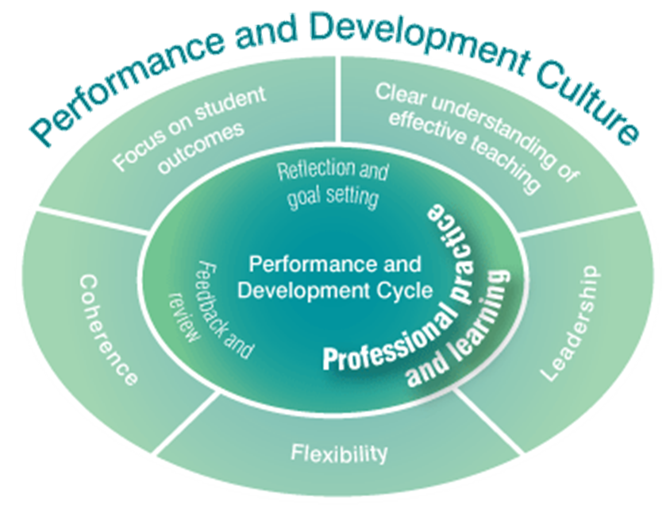
Professional practice and learning
An important part of effective professional practice is collecting evidence that provides
the basis for ongoing
feedback, reflection and further development.
Notes:
Purpose
To introduce the professional practice and learning component of the performance and development cycle.
Key points to share
Performance and development goals form the basis for subsequent action to change and improve teaching practice. An effective approach to improving practice will include a conscious effort to collect and reflect on evidence that provides insight into the effectiveness of teacher practice, and informs growth and access to high quality professional learning. This should occur in a context of frequent formal and informal feedback.
An important part of effective professional practice is collecting evidence that provides the basis for ongoing feedback, reflection and further development. The complex work of teaching generates a rich and varied range of evidence that can inform meaningful evaluations of practice for both formative and summative purposes.
Essential element: All teachers are supported in working towards their goals, including through access to high quality professional learning.
Essential element: Evidence used to reflect on and evaluate teacher performance, including through the full review described below, should come from multiple sources and include as a minimum: data showing impact on student outcomes; information based on direct observation of teaching; and evidence of collaboration with colleagues.
An effective approach to professional learning is further described in the Australian Charter for the Professional Learning of Teachers and School Leaders.
Research
‘Staff should be introduced to new teaching concepts, new work methods, be encouraged to exercise responsibility and generally operate in an environment where ongoing improvement is expected and constantly being pursued’ (Cole, P 2004, p. 9).
Materials required
The Australian Charter for the Professional Learning of Teachers and School Leaders.

Slide 11
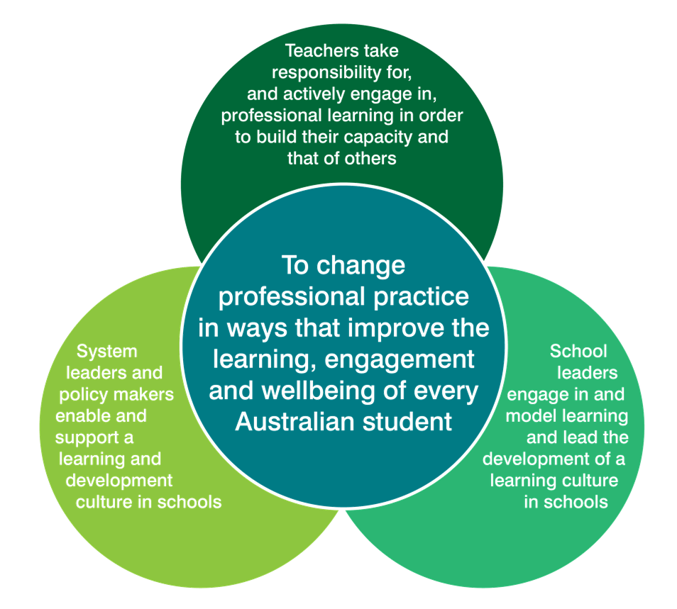
The Australian Charter for the Professional Learning of Teachers and School Leaders
Notes:
Purpose
To expand on the Framework’s companion document, the Australian Charter for the Professional Learning of Teachers and School Leaders and to explore effective approaches to professional learning.
Key points to share
There is clear evidence that purposeful professional learning for teachers and school leaders is one of the most effective strategies for improving student outcomes in our schools. The professional learning undertaken will vary to suit the context and priorities of teachers, leaders, schools, systems and sectors but the imperative to engage actively in high quality professional learning remains the same.
The Charter defines effective professional learning as a shared responsibility that must be taken up at all levels of the education system – by teachers, school leaders, system leaders and policy makers.
Changing culture and professional practices is not easy and will require sustained effort.
The Charter is a shared responsibility and commitment. It:
affirms the central importance of professional learning to teacher quality and student learning
recognises the importance of culture and context
articulates the expectation that professionals actively engage in professional learning throughout their careers
calls on teachers, school leaders and system leaders to take action.
The Charter describes three key characteristics of professional learning:
Relevant - effective professional learning is relevant because improving student outcomes is the ultimate goal of all teachers and school leaders, and of the professional learning they undertake. Professional learning will be most engaging for adult learners and have the greatest impacts on practice when it assists teachers and school leaders to address and adapt to the challenges they face in improving student learning, engagement and wellbeing.
Collaborative - learning is a collaborative process. Collaboration has a powerful effect in magnifying and spreading the benefits of professional learning and adds a new and valuable dimension to the learning undertaken by individuals. It connects teacher and leaders to their colleagues within and across schools and to external experts. Effective collaboration demands a disciplined and purposeful approach to collaborating to solve the challenges that are most important to improving student outcomes.
Future focused - a future focused approach to professional learning seeks to develop teachers and school leaders who are adaptable and able to deal with new and unexpected challenges. It exposes teachers to new and emerging practices and the theories that underpin them. It should focus not simply on improving existing practice, but also on assisting teachers and school leaders to understand the theory behind what practices work in different situations, and when and how to apply a broad repertoire of strategies.
Research
A professional learning culture is most likely to develop when there is high degree of leadership support for teacher learning and risk taking and when there is a high degree of staff interaction, trust and support. Just as a school must have high expectations for student learning, the leadership team needs to establish and act upon high expectations for teacher professional learning. Staff should be introduced to new teaching concepts, new work methods, be encouraged to exercise responsibility and generally operate in an environment where ongoing improvement is expected and constantly being pursued (Cole, P 2004, p. 9).

Slide 12
Activity: Professional learning
Individually read the Characteristics of effective professional learning from the Charter
Highlight a statement from each of the three characteristics that resonate with your view of a high quality learning culture and share these with your group
As a staff group identify three actions that should be taken to enhance the professional learning culture in your school
Notes:
Purpose
To have participants engage with the requirements for professional learning in their schools.
Key points to share
On average in TALIS countries participating in the OECD study, Creating effective teaching and learning environments, teachers participated in professional development for just under one day per month. A significant proportion of teachers think that professional development does not meet their needs: over half reported wanting more than they received during the previous 18 months. (OECD 2009, p. 48)
Research
Teachers’ perceived needs should also match the wider goals of school development and how well teachers’ professional development is coordinated with appraisal and feedback practices in schools and school evaluations more generally. (OECD, 2009)
Individual and group professional learning plans become highly effective tools for promoting teacher collaboration and classroom improvement when they are practical, action orientated and contain specific ‘bite sized’ learning tasks (Cole, 2012, p. 16)
On average across participating countries, teachers reported that the most effective forms of development were “Individual and collaborative research”, “Informal dialogue to improve teaching” and “Qualification programmes”, all with close to 90% of teachers reporting a moderate or large impact on their development as a teacher. The development activities that were reported to be relatively less effective were attendance at “Education conferences and seminars” and taking part in “Observation visits to other schools”, though even for these activities around 75% of teachers reported a moderate or high impact (OECD 2009).
Duration
10 minutes.
Materials required
Activity – Professional learning.
(The best size is A3 for ample room to write answers and reflections down)
Read pages 4-5 of the Charter.
Instructions
(See slide)
Activity Cards
There are related Activity Cards for the topics in this slide available at aitsl.edu.au

Slide 13

Effective performance and development practices
Click image to play
St Paul’s School, Queensland
Notes:
Purpose
To see an example of effective performance and development practice in an Australian school. St Paul’s has a particular focus on professional learning.
Key points to share
For the last six years St Paul’s school has amplified its focus on teaching and learning. The school initially developed a statement that outlines what effective teaching looks like at St Paul’s and this underpins performance and development in the school.
The school restructured their staffing to introduce Heads of Learning to implement strategies for improving teaching and learning.
The performance and development process involves teachers self-reflecting, informal and formal classroom observations, feedback from peers and students, and goal setting.
The school seeks to support teachers in achieving their professional goals by running their own professional learning in a dedicated onsite centre.
Materials required
View the video.
Read the Case Study – St Paul’s School, QLD.

Slide 14
Activity: Sources of evidence
What types of evidence have effectively demonstrated the achievement of your goals in the past?
What processes can school leaders implement to review teachers evidence and provide meaningful feedback ?
Notes:
Purpose
To have participants focus on different forms of evidence that can be used to reflect on and improve teaching practice
Key points to share
There are some forms of evidence that are particularly important in reviewing teacher performance. Evidence of student learning directly captures the outcomes of teaching, and must have a central role.
Potential sources of evidence:
Evidence of the impact of teaching on student outcomes
Direct observation of teaching
Evidence of the teacher’s impact on colleagues and the school as a whole
Student feedback
Peer/supervisor feedback
Parent feedback
Teacher self-assessment
Evidence of participation in professional learning and teacher reflection of it’s impact
Expected outcomes
Participants will articulate effective evidence teachers can collect and will discuss the best forms of evidence
Duration
10 minutes
Materials required
Activity sheet : Sources of Evidence worksheet from the Facilitators pack (the best size is A3 to allow the facilitator to collate and display ideas from the groups)
Instructions
Think, Group, Share
Form groups of 4
Discuss the two questions and record your responses on the worksheet provided.

Slide 15
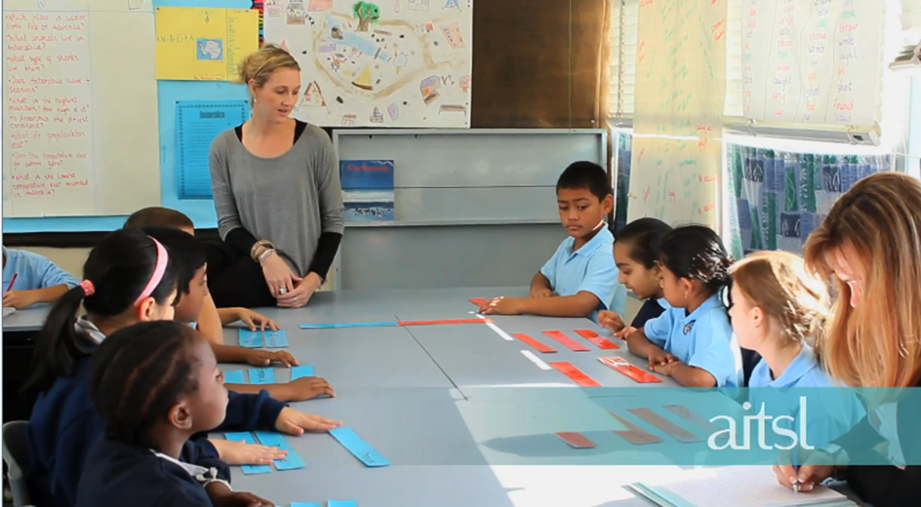
Effective performance and development practices
Click image to play
Dandenong North Primary School, Victoria
Notes:
Purpose
To see how one school is placing a focus on performance and development.
Key points to share
Dandenong North Primary School has long recognised the need to support teachers to improve their practice as a central component of their performance and development work is observation and feedback.
Introduce video – AITSL filmed in a range of locations with the goal of identifying, recognising and publishing existing effective practices.
The video promotes recognition and validation of extensive work and exemplary practice.
This video quickly and succinctly unpacks several of its practices which quite clearly lead to teacher satisfaction.
Encourage participants to look for existing practices being used at Dandenong North Primary School whilst they view the video.
Focus participants on the key message that there are already many great examples of effective performance and development practices occurring in Australian schools.
Research
Informal and formal observation and feedback informs teacher performance and development plans, supports coaching and collegiality and improvements in professional practice.
Research shows observation of classroom teaching, linked to timely and useful feedback that focuses on improvement, is a particularly useful tool for teacher development. This is the most commonly used form of evidence across OECD countries. (OECD, 2011)
Materials required
View the video.
Case Study – Dandenong North State School, VIC.
Duration
5 minutes.
Preparation
View the video – filmed at Dandenong North Primary School, Melbourne, Victoria – by clicking on the link embedded in the screen shot.
Read the Case Study.
Activity Cards
There are related Activity Cards for the topics in this slide available at aitsl.edu.au

Slide 16
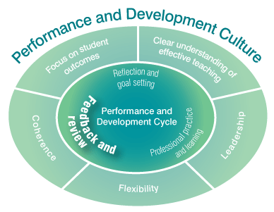
Feedback and review
Schools with an effective approach to teacher performance and development have a commitment to ongoing formal and informal
feedback and coaching
built into their culture.
Notes:
Purpose
To introduce the feedback and review component of the performance and development cycle.
To understand the importance of providing and receiving timely and meaningful feedback.
Key points to share
Schools with an effective approach to teacher performance and development have a commitment to ongoing formal and informal feedback and coaching built into their culture. Timely, frequent and improvement focused feedback supports teachers’ efforts to improve their practice, guides choices about professional learning, and informs reflection on and revision of performance and development goals.
Even in a context of frequent informal feedback, it is important to create space for a full reflection on a teacher’s performance against all of their performance and development goals, conducted using multiple sources of evidence gathered during the review period.
This most often takes the form of a formal annual performance and development review. Such a review should include the provision of verbal and written feedback that provides a basis for reflection on practice to inform further improvement during the next cycle.
Essential element: All teachers receive regular formal and informal feedback on their performance. This includes a formal review against their performance and development goals at least annually, with verbal and written feedback being provided to the teacher.
Effective feedback is focused and specifically based on observed or known information. It is behaviour focused, supportive, timely, useful, sufficient, respectful, verified, open and authentic.
Feedback presented well supports positive and effective professional relationships, which enhances a collaborative school culture.
Research
‘Meaningful appraisal is geared to teacher development and improvements in learning. It helps teachers improve their teaching skills by identifying and developing specific aspects of their teaching. It improves the way they relate to students and colleagues and their job satisfaction, and has a large impact on student outcomes’ (Jensen, B & Reichl, J 2011, p. 7).
‘Teachers who do receive appraisal and feedback view it positively: they want both to help them develop their practices. The vast majority of teachers (83%) agree that the appraisal and feedback they have received are fair (83%) and helpful in the development of their work (79%)’ (OECD 2012, p. 2).
Activity Cards
There are related Activity Cards for the topics in this slide available at aitsl.edu.au

Slide 17
Activity: Effective feedback
Reflect on a time when you received and provided effective feedback and were able to plan for positive change. What made this feedback effective?
What protocols should guide the delivery of feedback in your school?
Notes:
Purpose
To focus on what is effective feedback.
Key points to share
Teacher evaluation systems with these characteristics [greater levels of self-efficacy in their role as teachers receive more frequent evaluation and feedback about their work, are more likely to have innovative teaching practices emphasised in their evaluations] are more likely to have teachers that consider themselves to be more effective in their teaching and have a greater impact on students. (Jensen, B 2010, p. 23)
Expected outcomes
For participants to have a greater understanding of how to provide and receive effective feedback.
Duration
10 minutes.
Materials required
Activity – Effective feedback.
(The best size is A3 for ample room to write answers and reflections down).
Instructions
Think, Group, Share.
Individually, answer the two questions on the worksheet provided then discuss your reflections as a group.

Slide 18
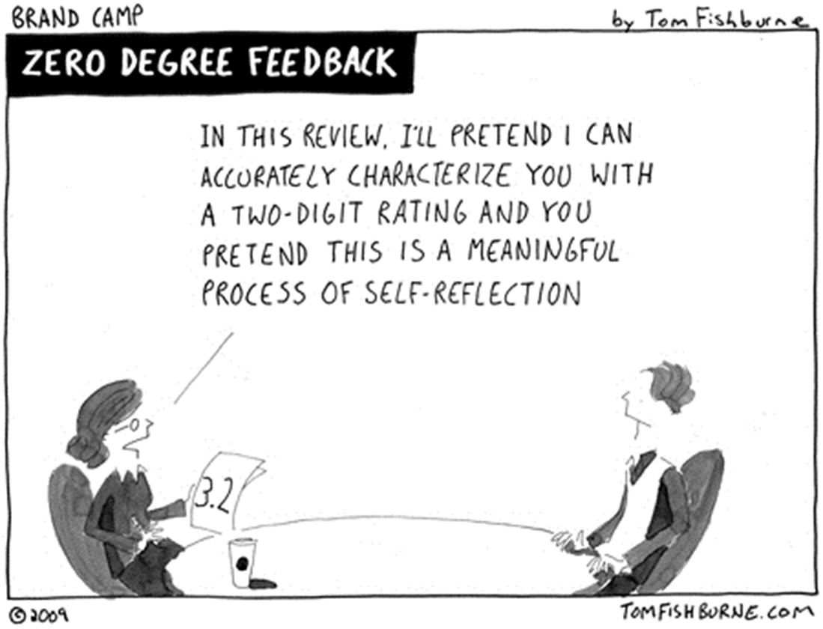
Activity: Formal review
Notes:
Purpose
To have participants focus on the cartoon message – this is not what effective performance and development is about.
Key points to share
As outlined in slide 16, even in a context of frequent informal feedback, it is important to create space for a full reflection on a teacher’s performance against all of their performance and development goals, conducted using multiple sources of evidence gathered during the review period.
This most often takes the form of a formal annual performance and development review. Such a review should include the provision of verbal and written feedback that provides a basis for reflection on practice to inform further improvement during the next cycle.
Essential element: All teachers receive regular formal and informal feedback on their performance. This includes a formal review against their performance and development goals at least annually, with verbal and written feedback being provided to the teacher.
Expected outcomes
Participants will begin to focus on the purpose of formal reviews as being about performance and development as a professional rather than a requirement for industrial reasons.
Duration
10 minutes.
Materials required
Activity – Formal review
(The best size is A3 to allow the facilitator to collate and display ideas from the groups).
Instructions
Discuss the two questions and record your responses on the worksheet provided.
Describe your experiences of annual formal reviews, with particular emphasis on its support for your performance and development.
What aspects of your school’s review process could be improved to enable greater support for teachers to improve their practice and realise their performance and development goals and the school’s strategic goals?

Slide 19

The Framework animation
Click image to play
Notes:
Purpose
To provide a summary to the Framework in a visually engaging way, providing participants with an overview of its key features and a context in which to understand the Framework.
Key points to share
As discussed in the introduction (slide 1) AITSL has collaborated with education stakeholders to develop the Australian Teacher Performance and Development Framework. The Framework has been developed based on research, national mapping and analysis of existing practices, advice from national and international experts, and national consultation.
Materials required
The Framework Discussion Wheel – printable desktop stimulus resource
The Framework Fact Sheet – Animation style
The Framework Infographic – Animation style

Slide 20
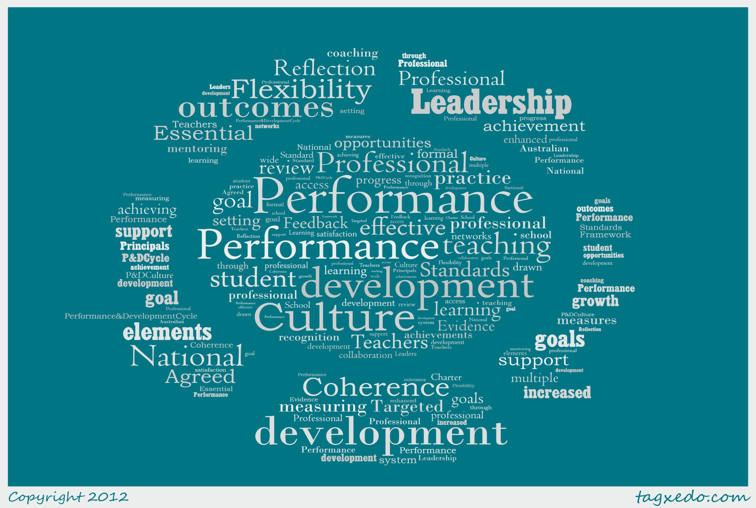
Notes:
Purpose
The closing key point is intended to refocus participants on why we as a nation are focusing on improving the teaching profession.
Key message
The Framework is a national statement which highlights what is required to build a comprehensive and effective approach to high performance and development. There is a growing body of evidence demonstrating that teachers thrive in a culture focused on improving teaching to improve student outcomes, and characterised by frequent feedback, coaching and access to high quality professional learning.

Slide 21





Connecting with AITSL
aitsl.edu.au
newsroom.aitsl.edu.au
performance@aitsl.edu.au
@aitsl
youtube.com/aitsleduau
iTunes U > Australian Institute for Teaching and School Leadership
www.facebook.com/aitsl
@
Notes:
Purpose
Social media is becoming an effective medium to connect, share and collaborate with educators within Australia and all over the world through professional learning networks (PLNs) and communities of practice.
References
Bell, M, Cordingley, P, Isham, C & Davis, R 2010, Report of professional practitioner use of research review: Practitioner engagement in and/or with research, CUREE, GTCE, LSIS and NTRP, Coventry, viewed 30 November 2012, <http://www.curee-paccts.com/files/publication/1297423037/Practitioner%20Use%20of%20Research%20Review.pdf>.
Cole, P 2004, Professional development: A great way to avoid change, IARTV, Melbourne.
Cole, P 2012, Linking effective professional learning with effective teaching practice, Independent paper prepared for AITSL, Melbourne, viewed 30 November 2012, <http://www.aitsl.edu.au/verve/_resources/Linking_effective_professional_learning_with_effective_teaching_practice_-_Cole.pdf>
Hay Group 2012, Growing our potential: Hay Group’s view on implementing an effective performance improvement and development framework for teachers, Independent paper prepared for AITSL, Melbourne, viewed 30 November 2012, <http://www.haygroup.com/Downloads/au/misc/Growing_our_potential_singles.pdf>.
Jensen, B & Reichl, J 2011, Better teacher appraisal and feedback: Improving performance, Grattan Institute, Melbourne, viewed 30 November 2012, <http://grattan.edu.au/static/files/assets/a9daf733/081_report_teacher_appraisal.pdf>.
Jensen, B 2010, What teachers want: Better teacher management, Grattan Institute, Melbourne, viewed 30 November 2012, <http://grattan.edu.au/static/files/assets/1cc095c7/033_report_what_teachers_want.pdf>.
Kamener, L, Boston Consulting Group 2012, Delivering real change in the approach to performance and development in schools, independent submission to AITSL, viewed 30 November 2012,
<http://www.aitsl.edu.au/verve/_resources/BCG_Schools_Delivering_Real_Change.pdf>.
Kruse, S, Louis, K & Bryk, A 1994, ‘Building professional community in schools’, Issues in restructuring schools, issue 6, viewed 30 November 2012, <http://www.wcer.wisc.edu/archive/cors/Issues_in_Restructuring_Schools/ISSUES_NO_6_SPRING_1994.pdf>.
MCEETYA 2008, Melbourne Declaration on Educational Goals for Young Australians, Ministerial Council on Education, Employment, Training and Youth Affairs, Melbourne.
OECD 2009, Creating effective teaching and learning environments: First results from TALIS, OECD, viewed 30 November 2012, <http://www.oecd.org/education/preschoolandschool/43023606.pdf>.
OECD 2012, Teaching in focus, viewed 30 November 2012, <http://www.oecd.org/edu/preschoolandschool/50446648.pdf>.

