Slide 1
Unpacking the
Australian Teacher Performance
and Development Framework
Notes:
Purpose
To familiarise the Australian education community with the Australian Teacher Performance and Development Framework.
Convey a consistent message to the education community.
Speak to the need for a shared national commitment to effective teacher performance and development.
Key points to share
AITSL has collaborated with education stakeholders to develop the Australian Teacher Performance and Development Framework.
The Framework has been developed based on research, national mapping and analysis of existing practices, advice from national and international experts, and extensive national consultation.
Through national consultation on implementation:
examples of existing best practices have been identified and shared the national conversation in education has begun to build a groundswell on creating a culture that values the performance and development of teachers nationally
a genuine environment for the implementation of effective teacher performance and development practices has been generated across the nation.
Expected outcomes
Build a shared understanding of effective approaches to teacher performance and development to improve outcomes for all young Australians.
Materials required
All resources are available at http://www.newsroom.aitsl.edu.au/blog/framework-support-materials
All participants will require copies of:
Australian Teacher Performance and Development Framework (the Framework).
The presentation will be enhanced if participants have access to the following additional Framework resources:
The Framework Discussion Wheel – printable desktop stimulus resource
The Framework Activity Cards – stimulus questions to generate discussion
The Framework Fact Sheet – Animation style
The Framework Infographic – Animation style
The Framework Frequently Asked Questions.
Companion documents :
Australian Professional Standards for Teachers (the Standards)
Australian Professional Standard for Principals (the Standard)
Australian Charter for the Professional Learning of Teachers and School Leaders (the Charter).

Slide 2

Innovative international practices
Click image to play
In today’s global economy, countries need high-quality education systems that
will teach their citizens the skills necessary to meet the challenges of tomorrow.
Strong Performers and Successful Reformers in Education, © OECD, 2011
http://www.oecd.org/document/7/0,3746,en_2649_35845621_49428807_1_1_1_1,00.html
Notes:
Purpose
To demonstrate that there is a collective global responsibility for this important work – it is ambition around supporting and improving teachers that will take the education profession forward.
Key points to share
Quote from the slide: In today’s global economy, countries need high-quality education systems that will teach their citizens the skills necessary to meet the challenges of tomorrow.
The video provides insight into approaches taken internationally, to stimulate discussion about priorities for Australia.
Featured in this video are Brazil, Singapore and Ontario, however a suite of full length videos can be found at the address on the slide.
Materials required
Preview the OECD Strong Performers and Successful Reformers in Education video – excerpts compiled by AITSL.
Complete set of OECD videos available at http://www.oecd.org/document/7/0,3746,en_2649_35845621_49428807_1_1_1_1,00.html
Research
Globalisation and technological change are placing greater demands on education and skill development in Australia and the nature of jobs available to young Australians is changing faster than ever. Skilled jobs now dominate job growth and people with university or vocational education and training qualifications fare much better in the employment market than early school leavers. To maximise their opportunities for healthy, productive and rewarding futures, Australia’s young people must be encouraged not only to complete secondary education, but also to proceed into further training and education.
(Melbourne Declaration on Educational Goals for Young Australians can be found at: http://www.mceecdya.edu.au/verve/_resources/National_Declaration_on_the_Educational_Goals_for_Young_Australians.pdf ).
Activity Cards
There are related Activity Cards for the topics in this slide available at aitsl.edu.au

Slide 3

Australia aims to be a world leader in education
Notes:
Purpose
To highlight that Australia is positioning itself to be a world leader in education.
Key points to share
Australia holds an enviable position globally. Not only do we have Australian Professional Standards for Teachers and Principals developed and endorsed by the profession, we can now also take pride in a national vision for teacher performance that is firmly grounded in development and professional learning.
The national education reform agenda has resulted in the following policies which demonstrate a consistent approach in all jurisdictions for all teachers across the country including, but not limited to, the following:
Australian Professional Standards for Teachers
Australian Professional Standard for Principals
Accreditation of Initial Teacher Education Programs in Australia: Standards and Procedures
Nationally Consistent Registration of Teachers in Australia
Certification of Highly Accomplished and Lead Teachers in Australia
Australian Teacher Performance and Development Framework
Australian Charter for the Professional Learning of Teachers and School Leaders
National Plan for School Improvement
The Australian Curriculum
National Quality Framework for Early Childhood Education and Care
Early Years Learning Framework and National Quality Standard.
Research
‘Over the next decade Australia should aspire to improve outcomes for all young Australians to become second to none amongst the world’s best school systems’ (MCEETYA 2008 p 5).
‘Together, all Australian governments commit to working with all school sectors and the broader community to achieve the educational goals for young Australians’ (MCEETYA 2008 p. 10).
Activity Cards
There are related Activity Cards for the topics in this slide available at aitsl.edu.au

Slide 4

Conservative estimates suggest that students with a highly effective teacher learn twice as much as students with a less effective teacher
B Jensen, Better teacher appraisal and feedback, Grattan Institute, 2011
The foundation
Australian teachers report that they do not always get the feedback they need to improve
The motivation
Notes:
Purpose
To emphasise that a focus on performance and development is being called for by Australian teachers and the education community across the nation.
Key points to share
‘All studies show that the key to higher performing students is the effectiveness of their teachers. Conservative estimates suggest that students with a highly effective teacher learn twice as much as students with a less effective teacher. Systems of teacher appraisal and feedback that are directly linked to improved classroom teaching and student performance can increase teacher effectiveness by as much as 20 to 30%. This would lift the performance of Australia’s students to the best in the world’ (Jensen, B & Reichl, J 2011 p. 6).
Emphasis needs to be placed not on the figures but on the needs being expressed by the teachers – more focused feedback and more targeted support.
63% of teachers believe that appraisals of their work are done purely to meet administrative requirements.
61% of teachers report that teacher appraisal has little impact on the way they teach in the classroom and provides them with little or no idea of how to improve their performance (Santiago, P et al 2011, pp. 86-7).
‘Focusing on student learning needs helped teachers to identify what they needed to learn to improve outcomes for students and gave them a compelling reason to engage in research. The most powerful element of the process was checking whether any changes in practice were having the desired impact on valued student outcomes’ (Bell, M et al 2010 p. 38).
Expected outcomes
Building a shared commitment and enthusiasm for effective professional dialogue across the nation.
Activity Cards
There are related Activity Cards for the topics in this slide available at aitsl.edu.au

Slide 5
The importance of teachers
Melbourne Declaration on Educational Goals for Young Australians, 2008
Goal 1: Australian schooling promotes equity and excellence
Goal 2: All young Australians become:
  successful learners
  confident and creative individuals
  active and informed citizens
Notes:
Purpose
To draw attention to the Melbourne Declaration on Educational Goals for Young Australians which is a public statement of all Australian Education Ministers’ commitment and a policy driver for the national education reforms taking place.
Key points to share
The Melbourne Declaration on Educational Goals for Young Australians makes clear that Australia aspires not to be among the best in the world, but to be the best. It acknowledges the challenges and opportunities of the 21st century and provides two simple, but powerful, goals to guide Australian education – see slide.
This speaks to the unequivocal evidence that the quality of teaching is the most significant in-school factor affecting student outcomes.
In the 21st century Australia’s capacity to provide a high quality of life for all will depend on the ability to compete in the global economy on knowledge and innovation. Education equips young people with the knowledge, understanding, skills and values to take advantage of opportunities and to face the challenges of this era with confidence.
Schools play a vital role in promoting the intellectual, physical, social, emotional, moral, spiritual and aesthetic development and wellbeing of young Australians, and in ensuring the nation’s ongoing economic prosperity and social cohesion.
Schools share this responsibility with students, parents, carers, families, the community, business and other education and training providers.
In recognition of this collective responsibility, this Declaration, in contrast to earlier declarations on schooling, has a broader frame and sets out educational goals for young Australians.
Materials required
(MCEETYA 2008, Melbourne Declaration on Educational Goals for Young Australians, viewed 1 December 2012, http://www.mceecdya.edu.au/verve/_resources/National_Declaration_on_the_Educational_Goals_for_Young_Australians.pdf)
Background research
‘The teachers and leaders who work in Australia’s schools and educate young people are of fundamental importance to achieving these educational goals for young Australians. Excellent teachers have the capacity to transform the lives of students and to inspire and nurture their development as learners, individuals and citizens. They provide an additional source of encouragement, advice and support for students outside the home, shaping teaching around the ways different students learn and nurturing the unique talents of every student’ (MCEETYA 2008 p. 11).
Activity Cards
There are related Activity Cards for the topics in this slide available at aitsl.edu.au

Slide 6
Importance of teacher performance and development
Quality of teaching
Improvement in student outcomes
Better appraisal and feedback
Targeted development
Notes:
Purpose
To place an emphasis on the effect of quality teaching and importance of appraisal and feedback.
To highlight that appraisal and feedback is very effective in some schools and systems but is not currently provided and available for all Australian teachers.
Key points to share
As discussed at slide 5, there is also strong evidence that better appraisal and feedback leading to targeted development can improve teacher performance.
Positive message:
teachers want effective feedback
teachers want support to develop and improve (both newly qualified and experienced teachers).
Teachers who do receive appraisal and feedback view it positively: they want both to help them develop their practices. The vast majority of teachers agree that the appraisal and feedback they have received are fair (83%) and helpful in the development of their work (79%) (OECD 2012, p. 2).
Although Australian teachers, according to OECD research, are not receiving the effective feedback they require, Australia is not alone in this – most OECD countries are the same, although there are pockets of excellence across sectors (TALIS, 2009) (statistics included in notes on slide 5).
Expected outcomes
Participants to see the need for a national Framework.
Research
‘Teachers are telling us that they work in systems that do not develop their skills or address weaknesses in their schools. They are bearing the burden of systems that fail to recognise effectiveness and therefore reward ineffectiveness. Change is clearly needed if we are to revitalise our school education system. We will lose our best teachers if change does not occur and we will continue to fail to attract the best and brightest into teaching. And the greatest impact will be on students. Students gain the greatest benefit from effective teaching and they lose the most from ineffective teaching’ (Jensen, B 2010 p. 27).
Activity Cards
There are related Activity Cards for the topics in this slide available at aitsl.edu.au

Slide 7

The Framework animation
Click image to play
Notes:
Purpose
To introduce the Framework in a visually engaging way, providing participants an overview of its key features and a context in which to understand the Framework.
Key points to share
As discussed in the introduction (slide 1) AITSL has collaborated with education stakeholders to develop the Australian Teacher Performance and Development Framework. The Framework has been developed based on research, national mapping and analysis of existing practices, advice from national and international experts, and national consultation.
Through national consultation on implementation of the Framework, examples of existing best practices have been identified, and a national conversation in education has begun to build a groundswell, creating a national culture that values the performance and development of teachers, and generating a genuine and effective environment for the implementation of effective teacher performance and development practices across the nation.
The Framework highlights what is required to build a comprehensive and effective approach to high teacher performance and development.
It outlines the components of a successful system and the culture that needs to be in place for sustained improvements to occur in schools.
It describes the characteristics of an effective performance and development cycle, including the elements of the cycle that are essential for success and should be implemented in all Australian schools.
The Framework will provide a structure for appraising, developing and improving teaching practice as well as recognising the entitlement of teachers to meaningful feedback and support.
Materials required
The Framework Discussion Wheel – printable desktop stimulus resource
The Framework Fact Sheet – Animation style
The Framework Infographic – Animation style

Slide 8
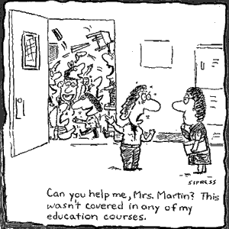
Activity: Vision
What should we be trying to achieve in our school through the implementation of effective performance and development practices?
Notes:
Purpose
To generate discussion on the Framework and to elicit references about participants’ school’s mission / vision / strategic plan, and to reflect on elements of the school’s profile, and capture their hopes and goals for the school’s future.
Key points to share
Effective performance and development processes are a collective responsibility and the support of the school community as a whole is critical.
Expected outcomes
Starting a dialogue about the Framework and a shared vision as to how to move forward as a team and acknowledgement of and focus on the school’s priorities.
Duration
10 – 15 minutes.
Materials required
Activity: The ‘Vision’
(The best size is A3 to allow the facilitator to collate the ideas from the groups to then display them).
Please note: This question may need to be altered to fit the context for the group with which you are working – i.e. If all participants are not from the same school.
Instructions
Work as a table group to brainstorm your responses.
After 10 minutes, each group to report back with 3 key points to the whole workshop.

Slide 9
An Australian Framework
The Framework recognises the entitlement of all teachers to know what is expected of them, receive ongoing, meaningful feedback and access to high quality professional learning.
  Focuses all schools on:
  creating a performance and development culture
  improving teaching
  improving student outcomes
  providing and receiving frequent feedback
  providing access to high quality support
  promoting genuine professional conversations
Notes:
Purpose
An introduction to the Framework.
Key points to share
Calls for the creation of a performance and development culture in all Australian schools:
with a clear focus on improving teaching.
as the means of improving student outcomes.
And requires that teachers;
know what is expected of them
receive frequent feedback
have access to high quality support.
Aims to promote genuine professional conversations.
Materials required
Read page 2 of the Framework.
Research
‘Ultimately, culture and leadership are going to be reinforced by successful outcomes. Where a robust framework is supported by enabling factors and strong local leadership in a conducive culture, it is likely that performance and development discussion will lead to growth, development and improvement in teachers and in turn to improving student learning’ (Hay Group 2012, p. 21).
‘For teachers who report receiving appraisal and feedback, many report changes in their teaching practices, especially on their emphasis on improving student test scores, student discipline, and classroom management’ (OECD 2012, p. 3).
Activity Cards
There are related Activity Cards for the topics in this slide available at aitsl.edu.au

Slide 10

Unpacking the Framework
A culture of performance and
development
Performance and development cycle
Essential elements
Importance of implementation
Notes:
Purpose
To highlight the four areas of the Framework.
Key points to share
The Framework highlights what is required to build a comprehensive and effective approach to high performance and development.
It outlines the characteristics of a successful system and the culture that needs to be in place for sustained improvements to occur in schools.
It describes the characteristics of an effective performance and development cycle.
It outlines the four Essential Elements of the cycle that are critical for success and should be implemented in all Australian schools. It is intended that these essential elements are common requirements and should be present in all Australian schools.
The Framework recognises that schools operate in different contexts and will be at different starting points, and the implementation of these essential elements will look different in different contexts. The pace and method of implementation of the Framework will be determined by jurisdictions, sectors and schools.
The Framework will provide a structure for appraising, developing and improving teaching practice as well as recognising the entitlement of teachers to meaningful feedback and support.
It is in the ongoing work of implementation and culture change that the real challenge lies. For this Framework to have an enduring impact, a strong commitment from, and extensive support for schools, groups of schools, teachers and school leaders will be critical.
Monitoring and evaluation is also critical to the sustained and successful implementation of this Framework.

Slide 11
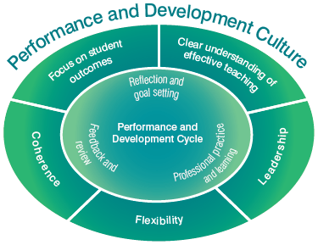
Performance and development culture
Focus on student outcomes
A clear understanding of effective teaching
Leadership
Flexibility
Coherence
Notes:
Purpose
To focus on the need for all these factors to be in place for a performance and development culture to flourish in schools.
Key points to share
A focus on student outcomes – Improving teaching is not an end in itself. It is directed at improving outcomes for students. The Framework defines student outcomes broadly to include student learning, engagement in learning and wellbeing, and acknowledges that these can be measured in a variety of ways.
A clear understanding of effective teaching – The Australian Professional Standards for Teachers outline what teachers should know and be able to do at four career stages. The Standards should be seen as providing the basis and a common language for coming to a shared understanding of what effective teaching looks like in the context of a particular school at a particular time.
Leadership – Research is clear on the critical role of leaders in creating a culture of performance and development. While it is acknowledged that principals have a central role, a performance and development culture cannot be driven by one person alone. A truly effective approach is characterised by a shared commitment to improvement and an acceptance that teachers have a powerful role to play in each others’ development, as well as their own.
Flexibility – All schools are different, and need to respond to their unique contexts and histories. Schools vary widely in their existing approaches to teacher performance and development. The Framework describes the elements of an effective approach to teacher performance and development, but acknowledges that these elements will look different in each school.
Coherence – Performance and development processes and teacher goals should reflect the overall approach to teaching and learning within a school, and should be consistent with the school plans. Alignment to school plans and school-wide approaches to professional learning are particularly important.
Research
‘To introduce and sustain an effective school-based performance and development system, a culture must exist among school leaders and teachers that is open to feedback and serious about performance and development — that is, a culture that sees performance management as much more than ticking boxes and development as much more than gaining credentials. The need for such a culture to exist makes it very difficult simply to impose a performance and development system from the centre, however close such a system might be to best practice‘ (Kamenar, L 2012, p. 5).
Our research suggests that human resources–such as openness to improvement, trust and respect, teachers having knowledge and skills, supportive leadership and socialization–are more critical to the development of professional community than structural conditions. (Kruse, S et al 1994, p. 6).
Materials required
Read pages 3 - 4 of the Framework.

Slide 12
Activity: Performance and development culture
Identify processes within your school that support the performance and development culture components outlined in the Framework
Notes:
Purpose
To identify processes within schools that support the performance and development culture components outlined in the Framework.
Key points to share
The Framework highlights what is required to build a comprehensive and effective approach to high performance and development.
Expected outcomes
That participants reflect on the performance and development processes within their schools and begin to identify areas in which there are room for improvements.
Duration
10 – 15 minutes.
Materials required
Activity – Performance and development culture.
Activity instructions
Work as a table group to brainstorm your responses.
After 10 minutes, each group to report back with 3 key points to the whole workshop.

Slide 13
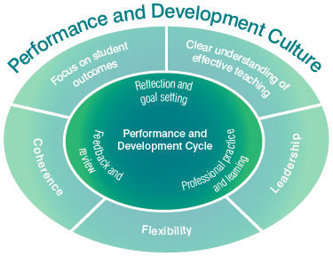
Performance and development cycle
Reflection and goal setting
Professional practice
and learning
Feedback and review
Notes:
Purpose
To introduce the components of an effective performance and development cycle.
Key points to share
Elements of the cycle are interwoven, will not necessarily occur in order and may take more or less time depending on circumstances.
However, the cycle provides a useful way of thinking about the process, and assists in identifying its important elements.
While these are necessary, they will not by themselves be sufficient to gain the maximum benefit from this process. However, it is important to be clear about common requirements and the minimum level of support that all teachers can expect in Australian schools.
Reflection and goal setting – To engage purposefully in performance appraisal and development all teachers, with the support of the principal or delegate, must clearly articulate agreed goals based on the school’s shared view of effective teaching derived from the Australian Professional Standards for Teachers. Goals should take into account the teacher’s own reflection on their teaching practice informed by evidence and feedback, and the school and system priorities. Goals should be measurable and reviewed regularly. Goals should address both teacher performance and teacher development.
Professional practice and learning – An effective approach to improving practice will include a conscious effort to collect and reflect on evidence that provides insight into the effectiveness of teacher practice, and informs growth and access to high quality professional learning. This should occur in a context of frequent formal and informal feedback. Engaging in high quality professional learning is a major strategy for improving teacher practice.
Feedback and review – Timely, frequent and improvement focused feedback supports teachers’ efforts to improve their practice, guides choices about professional learning, and informs reflection on and revision of performance and development goals. It is important that in the context of frequent informal feedback there is also a formal annual performance and development review including a full reflection on a teacher’s performance against all of their goals using multiple sources of evidence gathered.
Materials required
Read pages 5 - 7 of the Framework.
Research
Despite the importance of teacher appraisal and feedback, the majority of teachers report that they are not receiving it. An OECD survey of lower secondary teachers showed that, in Australia, current systems of teacher evaluation are largely seen as bureaucratic exercises, not linked to teacher development or improved classroom teaching
63% of Australian teachers report that appraisal of their work is largely done simply to fulfil administrative requirements
61% report that appraisal of their work has little impact on the way they teach in the classroom. The current systems of teacher appraisal and feedback do not identify nor recognise effective or innovative teaching in schools
91% of teachers report that in their school, the most effective teachers do not receive the greatest recognition
92% report that if they improved the quality of their teaching they would not receive any recognition in their school
91% report that if they were more innovative in their teaching they would not receive any recognition in their school (OECD 2009; Jensen, B 2010, p. 4).

Slide 14
Activity: Performance and development cycle
Identify processes within your school that support the performance and development cycle practices outlined in the Framework
Notes:
Purpose
To identify processes within schools that support the performance and development cycle components outlined in the Framework.
Key point
Performance and development processes will respond to school context. The components of the cycle will be implemented in a variety of ways.
Expected outcomes
For participants to identify and reflect on the existing performance and development cycle processes within their school or which would benefit their school and staff.
Duration
10 – 15 minutes.
Materials required
Activity – Performance and development cycle.
Instructions
Work as a table group to brainstorm your responses.
After 10 minutes, each group to report back with 3 key points to the whole workshop.

Slide 15
Essential elements for effective performance and development
The four essential elements should be present in all Australian schools so all teachers can:
Set performance and development goals
Be supported in working towards their goals
Collect evidence to use in reflection and evaluation
Receive feedback, including a formal review at least annually
Notes:
Purpose
To provide an overview of the essential elements within the performance and development cycle.
Key points to share
The Framework contains four essential elements that are derived from research and existing effective practice in Australian schools.
It is intended that the essential elements are common requirements and present in all Australian schools.
Performance and development cycle:
Reflection and goal setting
Essential element: All teachers have a set of documented and regularly reviewed goals related to both performance and development, and ways of measuring progress towards them, that are agreed with the principal or delegate.
Professional practice and learning
Essential element: All teachers are supported in working towards their goals, including through access to high quality professional learning.
Essential element: Evidence used to reflect on and evaluate teacher performance, including through the full review described below, should come from multiple sources and include as a minimum: data showing impact on student outcomes; information based on direct observation of teaching; and evidence of collaboration with colleagues.
Feedback and review
Essential element: All teachers receive regular formal and informal feedback on their performance. This includes a formal review against their performance and development goals at least annually, with verbal and written feedback being provided to the teacher.
Materials required
Read the essential elements in pages 5 - 7 of the Framework.

Slide 16
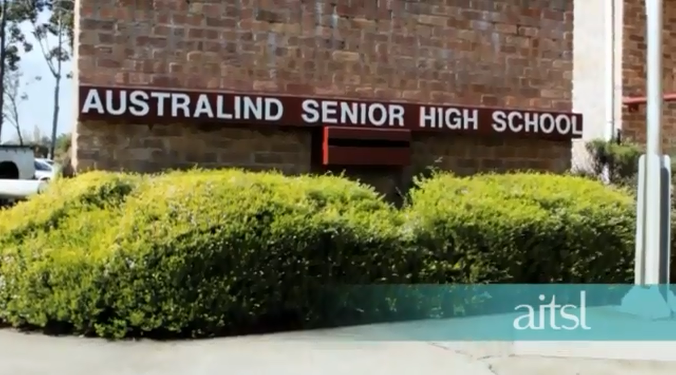
Effective performance and development practices
Click image to play
Australind Senior High School, WA
Notes:
Purpose
To focus on an example of existing performance and development processes in an Australian school.
Key points to share
The school’s entry point to performance and development was its decision to focus on quality teaching as a central component of its proposal to become an autonomous independent state school.
During 2011 the school established a pilot program that involved volunteer teachers drawn from a cross section of the staff carrying out a self-reflection of their teaching against the Australian Professional Teaching Standards for Teachers.
The self-reflection and feedback was accompanied by the guarantee that the teachers’ development needs as identified by the process itself would be met through appropriate teacher learning programs provided through the school.
A key to the implementation of the process to date has been the strong promotion and support provided by the school leadership.
Based on the success of the 2011 pilot the school has developed and extended this performance and development process to involve all teachers in 2012.
Materials required
View the video.
Read the Case Study – Australind Senior High School, WA.

Slide 17
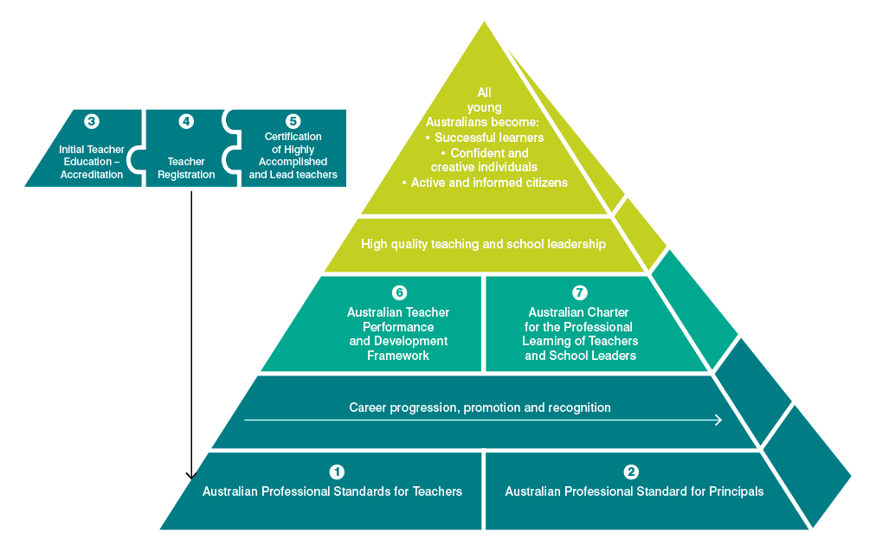
A coherent approach
Notes:
Purpose
To demonstrate the connection between processes that teachers undertake as part of their professional growth .
Key points to share
The diagram shows that the Australian Teacher Performance and Development Framework is supported by :
Australian Professional Standards for Teachers,
Australian Professional Standard for Principals
Australian Charter for the Professional Learning of Teachers and School Leaders.
This means that the Framework is consistent with:
Registration and renewal of registration
Certification of Highly Accomplished or Lead Teachers
supporting those aiming for career progression.
Materials required
Read page 8 of the Framework.

Slide 18
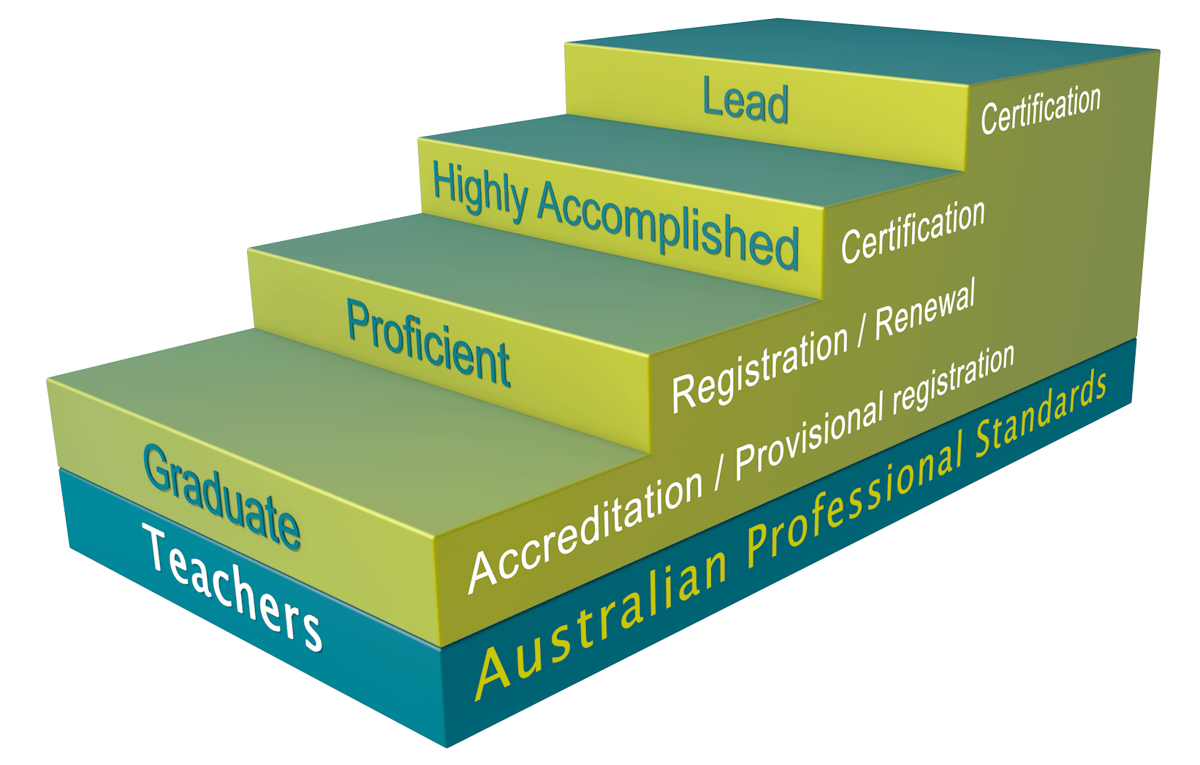
Australian Professional Standards for Teachers
Creation of a culture in all schools based on a clear understanding of effective teaching based on the Standards.
Notes:
Purpose
To understand how the Australian Professional Standards for Teachers align with the Framework.
Key points to share
A performance and development culture requires a clear understanding of effective teaching as outlined in the Australian Professional Standards for Teachers, with a clear focus on improving teaching as the means of improving student outcomes and requires that teachers know what is expected of them and receive frequent feedback and promote genuine professional conversations.
Aims of the Australian Professional Standards for Teachers in use with the Framework:
Assist in self-reflection and self-assessment
Inform the development of performance and professional learning goals
Basis for ongoing informal and formal feedback, including classroom observations
Provide a framework by which teachers can judge the success of their learning
Provide a basis for review of and evidence against the achievement of goals.
The Australian Professional Standards for Teachers outlines what teachers should know and be able to do at four career stages and they provide a common language for coming to a shared understanding of what effective teaching looks like in the context of a particular school:
Four professional Career stages:
Graduate – Proficient – Highly Accomplished – Lead.
Three Domains:
Professional Knowledge
Professional Practice
Professional Engagement.
The seven Standards for teachers:
Know students and how they learn
Know the content and how to teach it
Plan for and implement effective teaching and learning
Create and maintain supportive and safe learning environments
Assess, provide feedback and report on student learning
Engage in professional learning
Engage professionally with colleagues, parents/carers and the community.
Development of Australian Professional Standards for Teachers
AITSL consulted broadly in the development/finalisation of the Standards.
Endorsed by MCEECDYA in December 2010.
Launched by Ministers in February 2011.
Materials required
The Australian Professional Standards for Teachers.

Slide 19
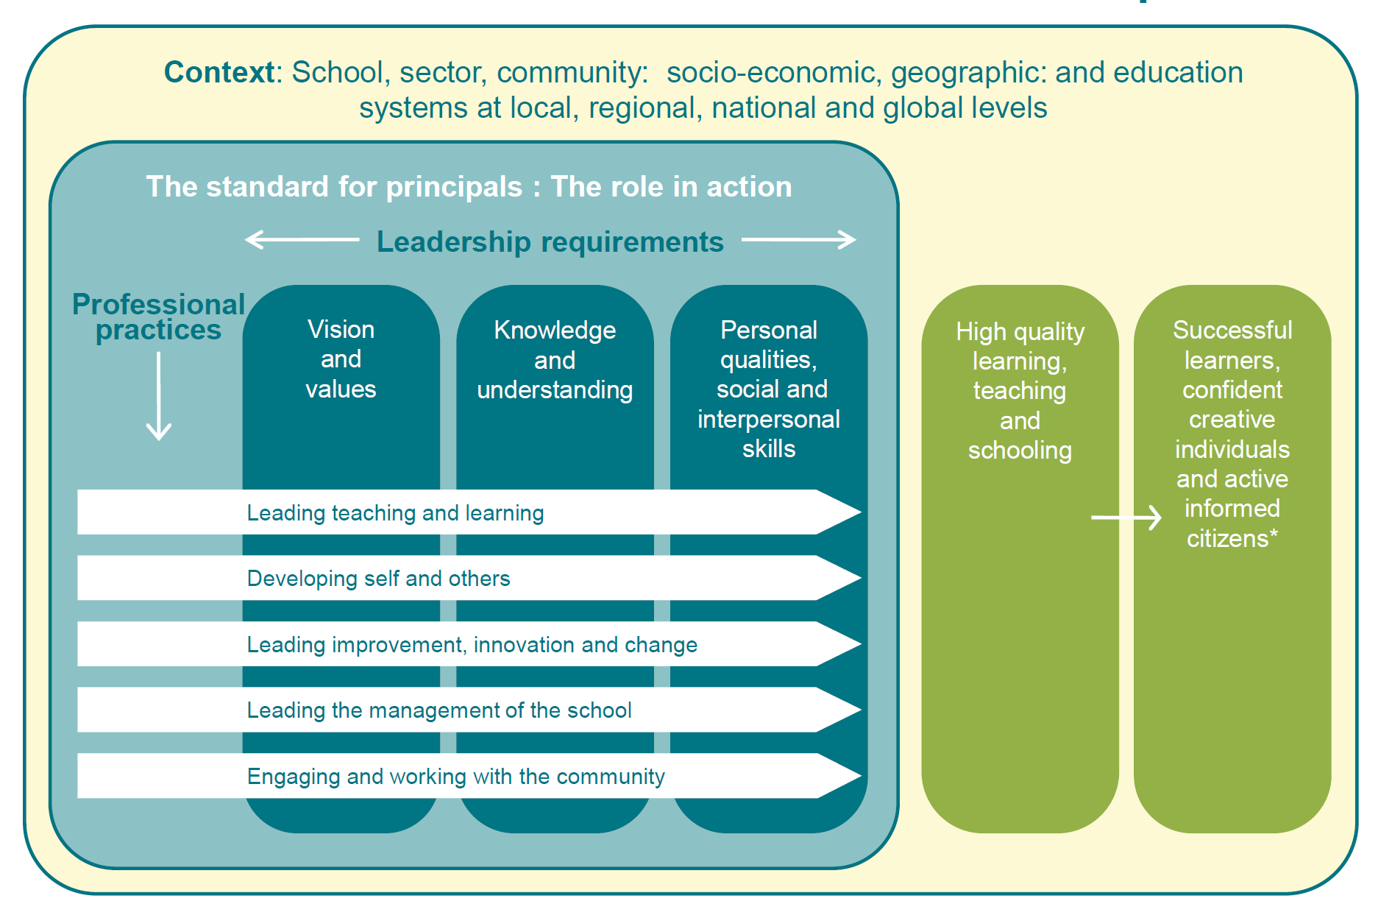
Australian Professional Standard for Principals
The role of the leader is critical in creating a culture of performance and development. However, leadership is required from all levels and is a shared commitment.
Notes:
Purpose
To understand how the Australian Professional Standard for Principals aligns with the Framework.
Key points to share
While it is acknowledged that principals have a central role, a performance and development culture cannot be driven by one person alone. Leadership must come from all levels, from those with and without formal leadership positions.
A truly effective approach is characterised by a shared commitment to improvement and an acceptance that teachers have a powerful role to play in each others’ development, as well as their own.
Makes clear the role of the principal in leading teaching and learning, developing him or herself and others, and leading improvement in a school. All these elements are central to a performance and development culture.
The Australian Professional Standard for Principals takes into account the crucial contribution made by principals:
Raising student achievement at all levels and all stages.
Promoting equity and excellence.
Creating and sustaining the conditions under which influencing, developing and delivering community expectations and government policy quality teaching and learning thrive.
Contributing to the development of a 21st century education system at local, national and international levels.
Aims of the Australian Professional Standard for Principals
A public statement which sets out what principals are expected to know, understand and do to achieve in their work.
Provides a framework for professional learning.
A basis to inform strategies for attracting, preparing and developing principals for leading 21st century Schools.
Guide to self-reflection, self-assessment and development.
Guide to inform the management of self and others.
Development of the Australian Professional Standard for Principals
Endorsed by Ministers in July 2011.
Research
‘“…nearly 60% of a school’s impact on student achievement is attributable to principal and teacher effectiveness. These are the most important in-school factors driving school success, with principals accounting for 25% and teachers 33% of a school’s total impact on achievement.” This statement may even understate the potential impact of effective school leadership, because leadership is itself one of the main drivers of the quality of teaching’ (Barber, M et al 2010, p. 5).
Materials required
The Australian Professional Standard for Principals.

Slide 20
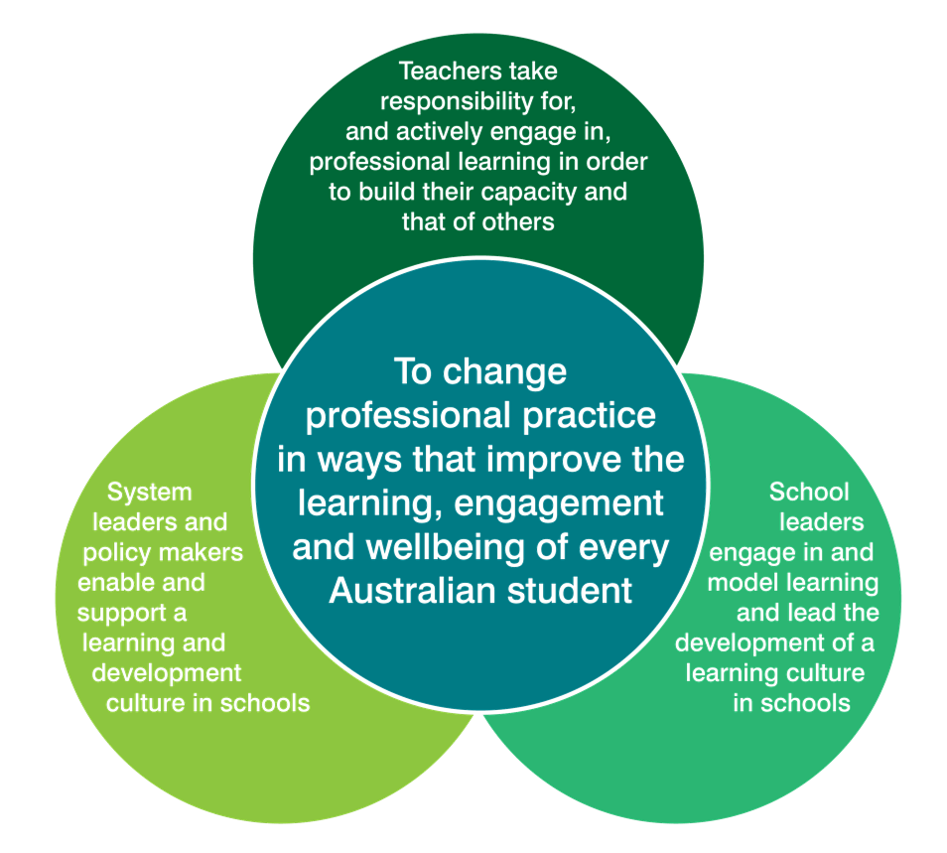
Australian Charter for the Professional Learning of Teachers and School Leaders
Engaging in high quality professional learning is a major strategy for improving teacher practice.
Notes:
Purpose
To understand how the Australian Charter for the Professional Learning of Teachers and School Leaders aligns with the Framework.
Key points to share
The Charter is a companion document to the Framework.
Based on research, the Charter identifies the importance of a learning culture within a school, and emphasises that professional learning should be based on changing teacher practice to meet student needs.
Consistent with this focus, access to professional learning opportunities should be negotiated to take into account the priorities and resources of schools.
The Charter articulates the expectation that professionals actively engage in professional learning throughout their careers.
There is clear evidence that purposeful professional learning for teachers and school leaders is one of the most effective strategies for improving student outcomes in our schools.
The Charter defines effective professional learning as a shared responsibility that must be taken up at all levels of the education system – by teachers, school leaders, system leaders and policy makers.
The Charter describes three key characteristics of professional learning:
Relevant: because improving student outcomes is the ultimate goal of all teachers and school leaders, and of the professional learning they undertake.
Collaborative: effective collaboration demands a disciplined and purposeful approach to collaborating to solve the challenges that are most important to improving student outcomes.
Future focused: professional learning seeks to develop teachers and school leaders who are adaptable and able to deal with new and unexpected challenges. It exposes teachers to new and emerging practices and the theories that underpin them.
Research
‘A professional learning culture is most likely to develop when there is a high degree of leadership support for teacher learning and risk taking and when there is a high degree of staff interaction and co-dependence. Consequently strategies designed to produce these conditions need to be implemented.’ (Cole, 2010, p. 9)
Materials required
The Australian Charter for the Professional Learning of Teachers and School Leaders.
Activity Cards
There are related Activity Cards for the topics in this slide available at aitsl.edu.au

Slide 21

The Framework Overview
Click image to play
Notes:
Purpose
To provide an overview of the Framework as a summary for the presentation.
To view the Framework in a different and engaging format, exposing participants to different points of view, including that of peers and students.
Key points to share
As discussed in the introduction (slide 1) AITSL has collaborated with education stakeholders to develop the Australian Teacher Performance and Development Framework. The Framework has been developed based on research, national mapping and analysis of existing practices, advice from national and international experts, and national consultation.

Slide 22
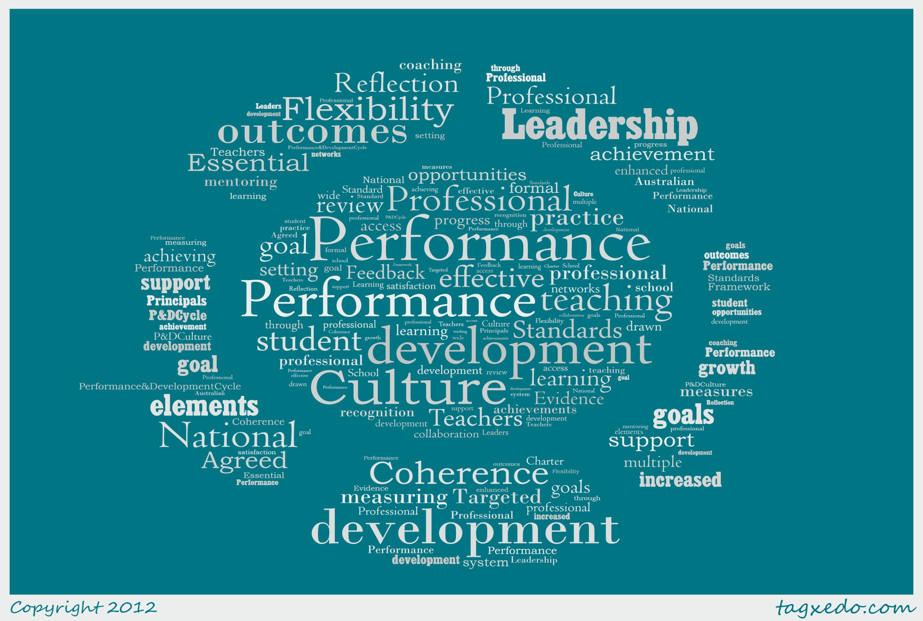
Notes:
Purpose
To use the closing key point to refocus participants on why we as a nation are focusing on improving the teaching profession.
Key message
Changing culture and professional practices is not easy and will require sustained effort.
Improving teacher quality through a performance and development culture is important work that is worth doing. It is also a collective responsibility.
The next step is for all involved in Australian education to take a deliberate, structured and long-term approach to building a culture that provides a satisfying and challenging environment in which all Australian teachers can improve their practice and the outcomes their students achieve.

Slide 23





Connecting with AITSL
aitsl.edu.au
newsroom.aitsl.edu.au
performance@aitsl.edu.au
@aitsl
youtube.com/aitsleduau
iTunes U > Australian Institute for Teaching and School Leadership
www.facebook.com/aitsl
@
Notes:
Purpose
Social media is becoming an effective medium to connect, share and collaborate with educators within Australia and all over the world through professional learning networks (PLNs) and communities of practice.
References
Barber, M, Whelan, F & Clark, M 2010, Capturing the leadership premium: How the world's top school systems are building leadership capacity for the future, McKinsey, London, viewed 30 November 2012,
<http://mckinseyonsociety.com/downloads/reports/Education/schoolleadership_final.pdf>.
Bell, M, Cordingley, P, Isham, C & Davis, R 2010, Report of professional practitioner use of research review: Practitioner engagement in and/or with research, CUREE, GTCE, LSIS and NTRP, Coventry, viewed 30 November 2012, <http://www.curee-paccts.com/files/publication/1297423037/Practitioner%20Use%20of%20Research%20Review.pdf>.
Cole, P 2004, Professional development: A great way to avoid change, IARTV, Melbourne.
Hay Group 2012, Growing our potential: Hay Group’s view on implementing an effective performance improvement and development framework for teachers, Independent paper prepared for AITSL, Melbourne, viewed 30 November 2012, <http://www.haygroup.com/Downloads/au/misc/Growing_our_potential_singles.pdf>.
Jensen, B & Reichl, J 2011, Better teacher appraisal and feedback: Improving performance, Grattan Institute, Melbourne, viewed 30 November 2012, <http://grattan.edu.au/static/files/assets/a9daf733/081_report_teacher_appraisal.pdf>.
Jensen, B 2010, What teachers want: Better teacher management, Grattan Institute, Melbourne, viewed 30 November 2012, <http://grattan.edu.au/static/files/assets/1cc095c7/033_report_what_teachers_want.pdf>.
Kamener, L, Boston Consulting Group 2012, Delivering real change in the approach to performance and development in schools, independent submission to AITSL, viewed 30 November 2012,
<http://www.aitsl.edu.au/verve/_resources/BCG_Schools_Delivering_Real_Change.pdf>.
Kruse, S, Louis, K & Bryk, A 1994, ‘Building professional community in schools’, Issues in restructuring schools, issue 6, viewed 30 November 2012, <http://www.wcer.wisc.edu/archive/cors/Issues_in_Restructuring_Schools/ISSUES_NO_6_SPRING_1994.pdf>.
MCEETYA 2008, Melbourne Declaration on Educational Goals for Young Australians, Ministerial Council on Education, Employment, Training and Youth Affairs, Melbourne.
OECD 2009, Creating effective teaching and learning environments: First results from TALIS, OECD, viewed 30 November 2012, <http://www.oecd.org/education/preschoolandschool/43023606.pdf>.
OECD 2012, Teaching in focus, viewed 30 November 2012, <http://www.oecd.org/edu/preschoolandschool/50446648.pdf>.
Santiago, P, Donaldson, G, Herman, J & Shewbridge, C 2011, OECD Reviews of evaluation and assessment in education: Australia, OECD, Paris, viewed 30 November 2012 <http://www.oecd.org/education/preschoolandschool/48519807.pdf>.

