Slide 1
Introducing
the Leadership Profiles
Notes:
Slide 1 – page no. 5

Slide 2
Session aims
Affirm a focus on leadership learning
Introduce the Leadership Profiles
Explore the Interactive Leadership Profiles
Introduce the School Leaders Self-Assessment Tool
Link the Profiles to professional growth planning
Notes:
Slide 2 – page no. 6

Slide 3

Introducing the Profiles
Notes:
Slide 3 – page no. 7

Slide 4
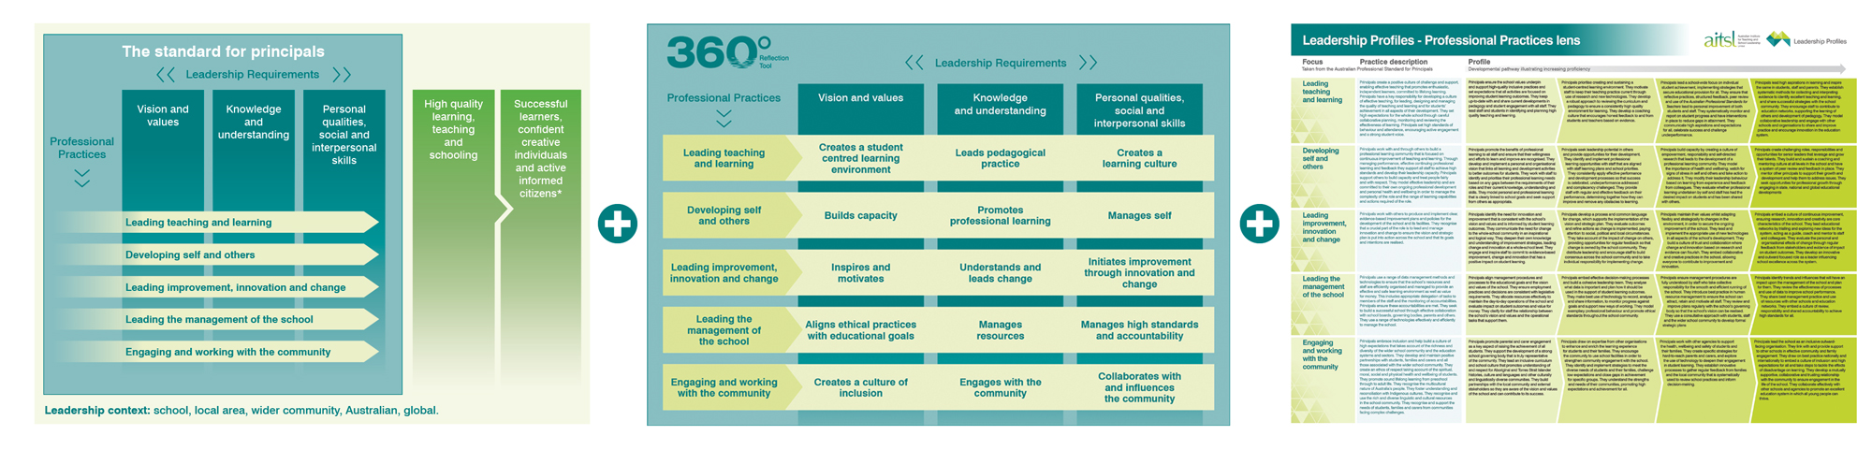
Where did the Leadership Profiles
come from?
Australian Professional Standard for Principals (2011)
360°Reflection Tool (2013)
Leadership Profiles (2014)
Notes:
Slide 4 – page no. 8

Slide 5

So, what exactly are the Profiles?
The Profiles are a set of 80 statements that describe the leadership actions of principals as they progress to higher levels of proficiency.
They have been developed by the profession, for the profession.
Notes:
Slide 5 – page no. 10

Slide 6

What do the Profiles do that’s different?
Comprehensive developmental framework, not a capability check list
Acknowledge the dynamic nature of leadership
Development pathways that can be seen through different lenses
Notes:
Slide 6 – page no. 11

Slide 7




For current and aspiring principals
Talent development
and succession
Identifying professional learning for self and leadership team
Self and leadership team reflection
Coaching and mentoring
Notes:
Slide 7 – page no. 12

Slide 8


For system leaders
Talent development and succession
Selection and recruitment
Performance and development
Identifying professional learning for individuals and groups
Notes:
Slide 8 – page no. 13

Slide 9
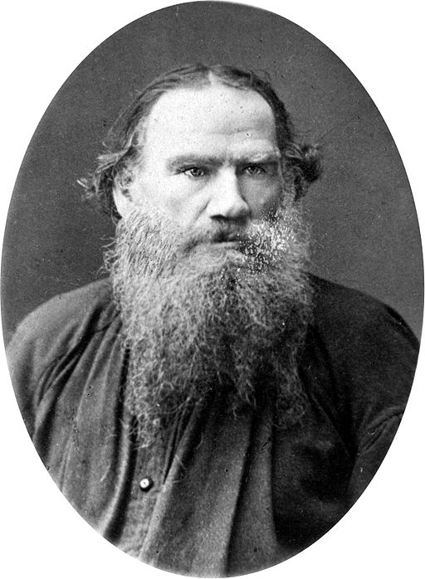

Everyone wants to change the world, no one wants to change themselves.
– Leo Tolstoy
Notes:
Slide 9 – page no. 14

Slide 10

Model of Behaviour change
Notes:
Slide 10 – page no. 14

Slide 11
Awareness
EXAMPLE
Ben has always struggled with giving feedback to under-performing staff. He has become aware that, in his new role, he will need to engage in these difficult conversations to embed his leadership and bring about whole-school improvement.
Notes:
Slide 11 – page no. 16

Slide 12
Attitude
EXAMPLE
Ben is determined to overcome his reluctance to say what he is thinking and stop skirting around difficult issues. He feels that, in the past, he has not been sufficiently honest and direct with staff. His commitment to becoming an effective leader has given him the drive and confidence to believe he can tackle this reluctance.
Notes:
Slide 12 – page no. 17

Slide 13
Knowledge
EXAMPLE
To build his knowledge about providing negative feedback, Ben uses the online Leadership Profiles resources to explore how to develop his interpersonal skills and relationships with others. In his research, he comes across ‘Fierce Conversations’ by Susan Scott and finds the case studies and exercises are really helpful in planning what he is going to do.
Notes:
Slide 13 – page no. 18

Slide 14
Action
EXAMPLE
Ben discusses the approach he plans to take with his mentor and begins by tackling an issue that has been troubling him since he arrived at the school – the lack of punctuality of two members of staff.
Notes:
Slide 14 – page no. 19

Slide 15
Behaviour change
EXAMPLE
Ben begins to realise that people expect him to be truly authentic in his role. Far from ‘damaging’ those he has robust conversations with, they start to respect him and take on board his feedback.
Notes:
Slide 15 – page no. 20

Slide 16
Activity
Attitudes influence behaviour change
Write down attitudes that have helped you change your
behaviour (enablers)
Write down attitudes that have stopped you from making
changes (blockers)
Share with a table partner
Notes:
Slide 16 – page no. 21

Slide 17
Attitudes that enable change
Openness – to ideas, possibilities, surprise
Questioning – restlessness
Inventiveness – creative responses to challenges
Persistence – courage, humility
Emotional stability – taking risks and resilience
Generosity – welcoming difference
Empathy – mutual supportiveness
Notes:
Slide 17 – page no. 22

Slide 18
Attitudes that block change
Belief in one right way – and predictable outcomes
Reliance on certainties – and ready-made solutions
Compliance – with imposed models and materials
Rejecting complexity – settling for easy answers
Fear of failure – and trying new things
Deficit thinking – desire for uniformity
Fear – defensiveness and blame
Notes:
Slide 18 – page no. 23

Slide 19
Exploring the Profiles
- structure
Notes:
Slide 19 – page no. 24

Slide 20
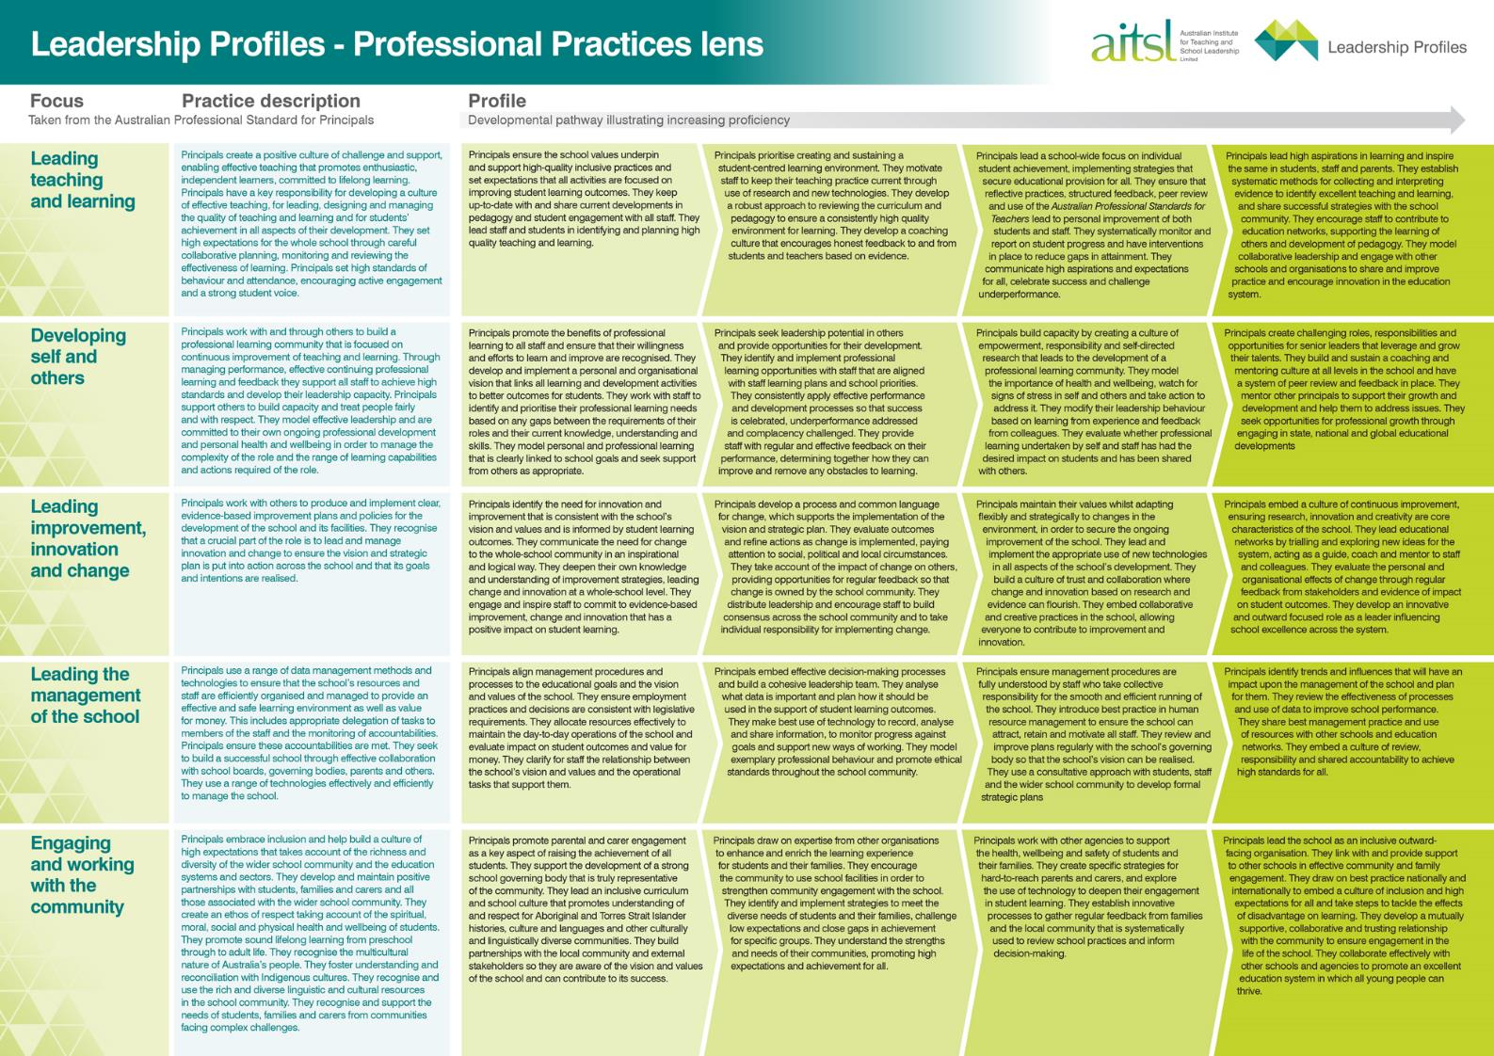
Summary
Table
Notes:
Slide 20 – page no. 25

Slide 21
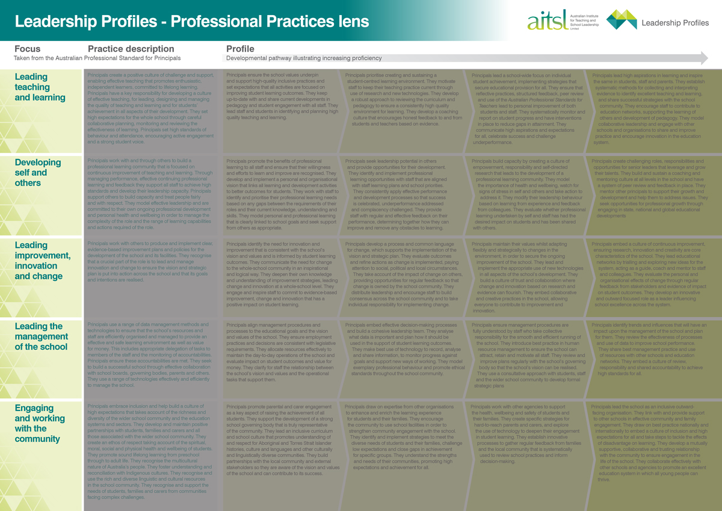
Focuses
Notes:
Slide 21 – page no. 26

Slide 22
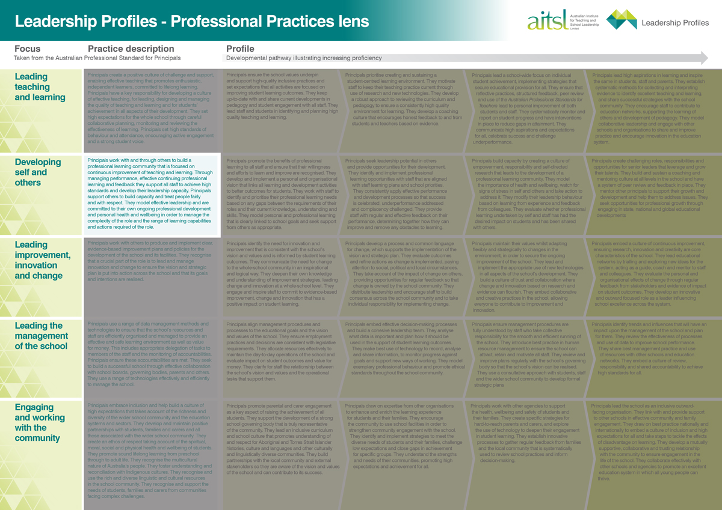
Practice description (from the Standard)
Notes:
Slide 22 – page no. 26

Slide 23
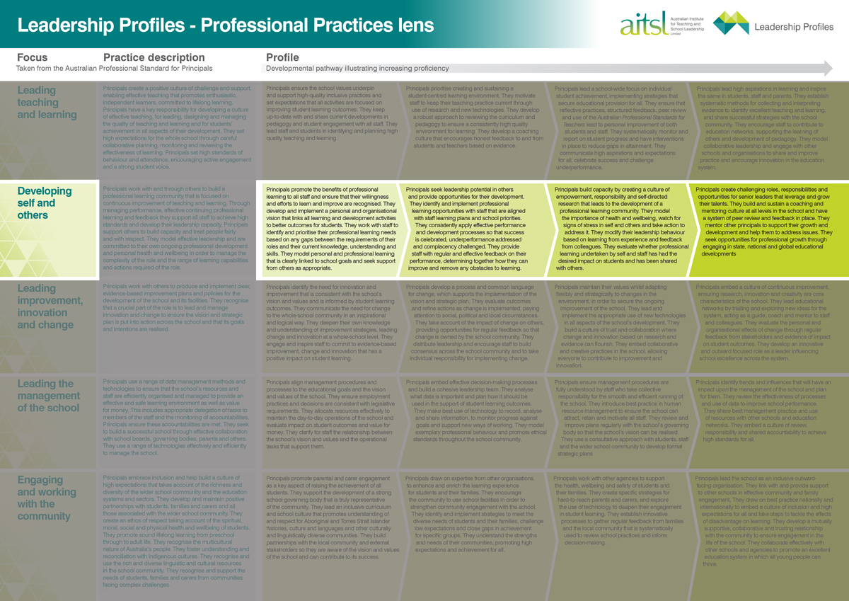
Profile
Notes:
Slide 23 – page no. 27

Slide 24
Profiles: Progressive and increasing in proficiency
Statement of early proficiency
Principals promote the benefits of professional learning to all staff and make sure that their willingness and efforts to learn and improve are recognised. They develop and implement an organisational vision which links all learning and development activities to better student outcomes ………
Statement of later proficiency
Principals create challenging roles, responsibilities and opportunities for senior leaders that leverage and grow the talents of others. They build and sustain a coaching and mentoring culture… and have a system of peer review and feedback in place ………
Notes:
Slide 24 – page no. 30

Slide 25
Exploring the Profiles
- Leadership lenses
Notes:
Slide 25 – page no. 30

Slide 26
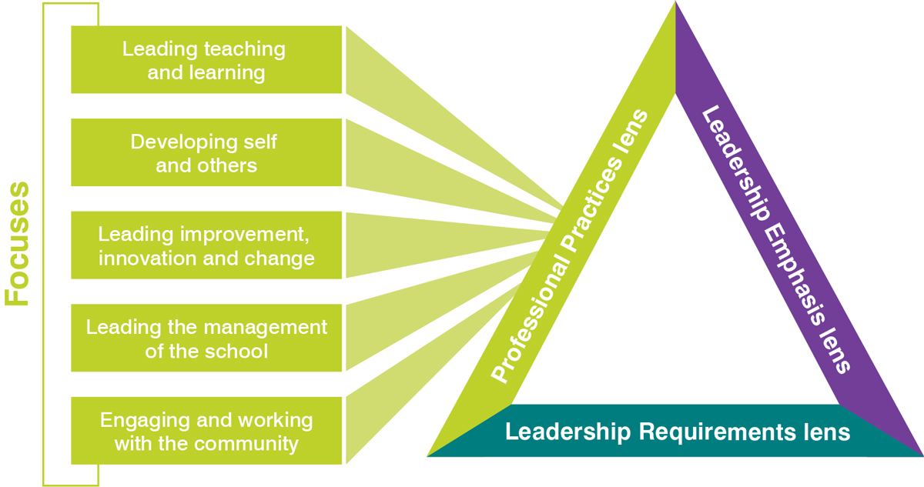
Professional Practices lens
Notes:
Slide 26 – page no. 31

Slide 27
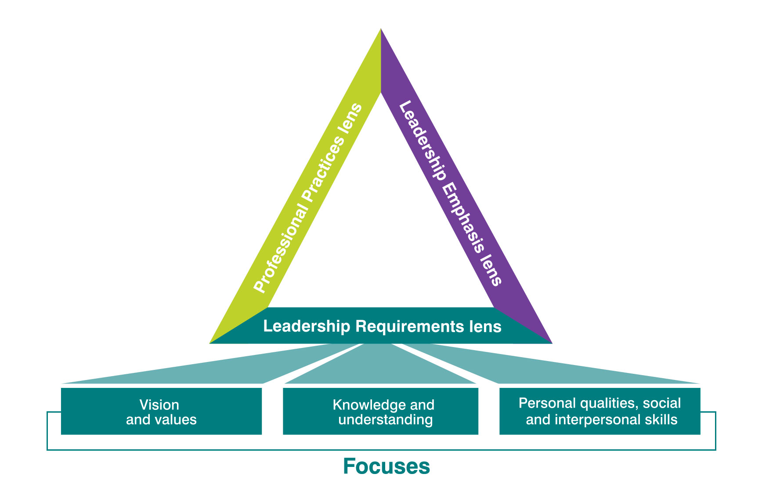
Leadership Requirements lens
Notes:
Slide 27 – page no. 32

Slide 28

Leadership Requirements lens
Vision and values Knowledge Personal qualities
Principals prioritise creating and sustaining a student-centred learning environment. They motivate staff to keep their teaching practice current through use of research and new technologies. They develop a robust approach to reviewing the curriculum and pedagogy to ensure a consistently high quality environment for learning. They develop a coaching culture that encourages honest feedback to and from students and teachers based on evidence.
Core Lens: Professional Practices, Focus: Leading teaching and learning, Profile: 2nd paragraph
Notes:
Slide 28 – page no. 32

Slide 29
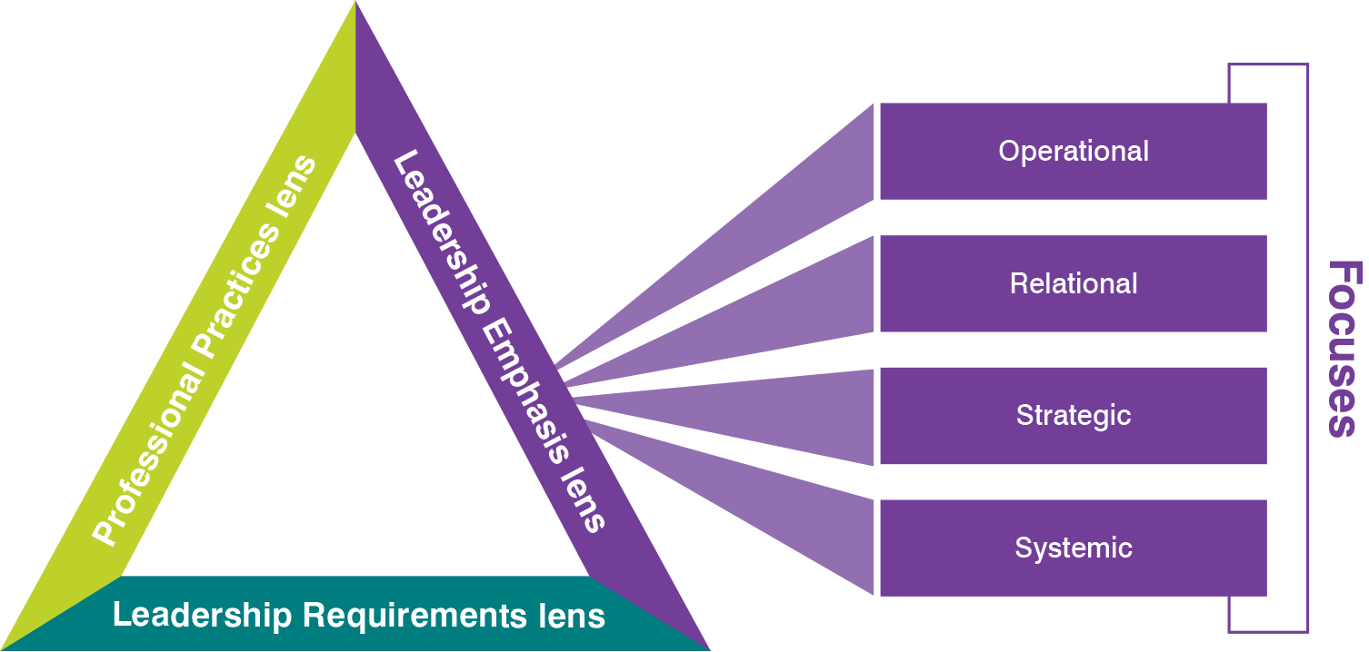
Leadership Emphasis lens
Notes:
Slide 29 – page no. 34

Slide 30
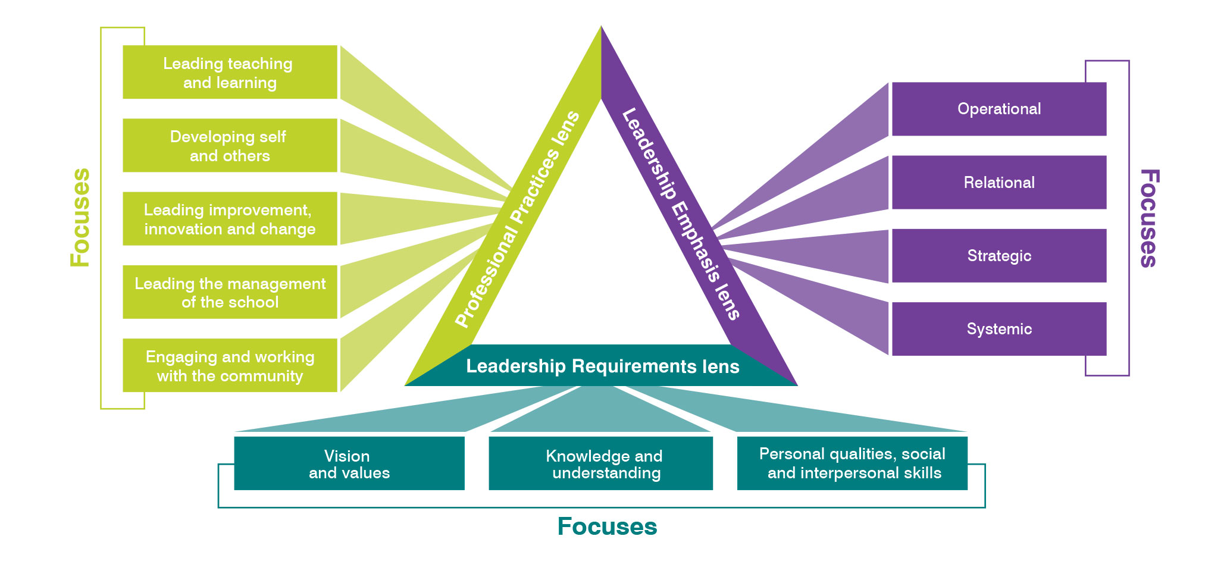
Leadership through different lenses
Notes:
Slide 30 – page no. 35

Slide 31

Interactive Leadership Profiles
Demonstration
aitsl.edu.au/leadership-profiles
Notes:
Slide 31 – page no. 36

Slide 32
Activity
  Explore the Interactive Leadership Profiles. With a partner, discuss:
  How you will use the Leadership Profiles in your role?
  Which lens is most appropriate to your current situation?
Notes:
Slide 33 – page no. 47

Slide 33
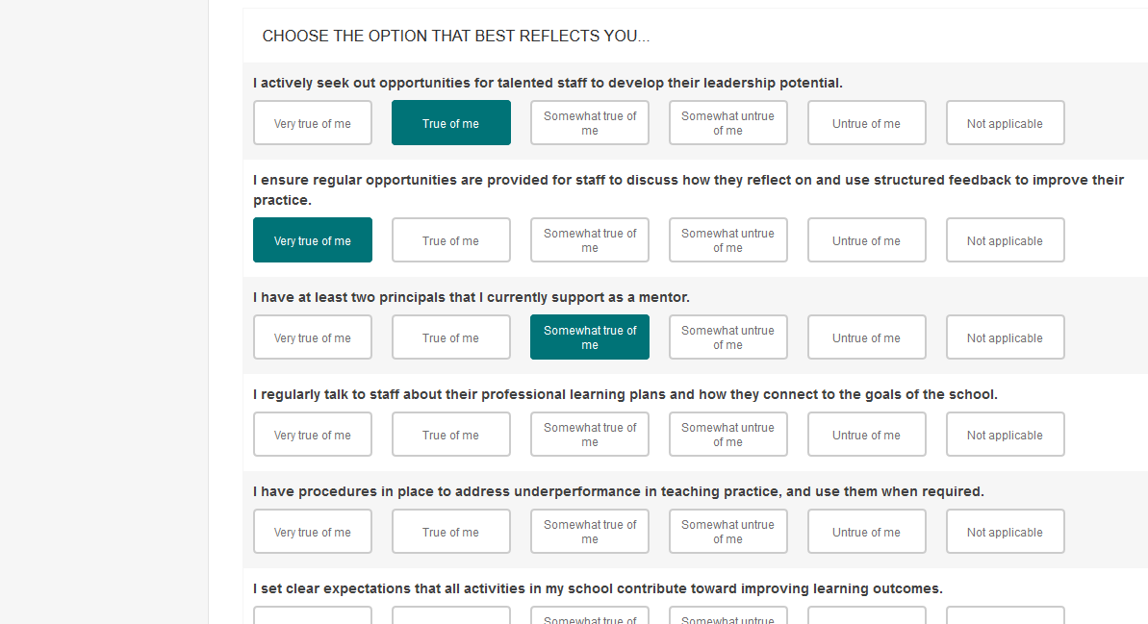
Profiles online
School Leader Self-Assessment Tool
Notes:
Slide 34 – page no. 48

Slide 34






Where to find out more
aitsl.edu.au/leadership-profiles
schoolleadership@aitsl.edu.au
eNews – register at aitsl.edu.au
Notes:
Slide 33 – page no. 49

